Slide 1

Dow Jones Index Estimator
Prepared for: Statistics, Probability & Inference
Prepared By: Josh Levine (jl2108), Harsh Patel (hkp49), Jaini Patel (jp1891), Yifan Liao (yl1463) and
Aayush Shah (avs93)

Slide 2
Goal
Analyze the moving average index of the Dow Jones using a Time Series and ARIMA model.
In our analysis we aim to predict one day or one week in the future of the index.
Analyze our prediction.

Slide 3
The Data
Two data sets, one is index data on a daily basis and the other on a weekly basis.
The data starts in 1896 and runs into 2020.
Our starting file was the daily index and we wrote a python script to combine in by week.
In our analysis we are using the opening data as that days index value.

Slide 4
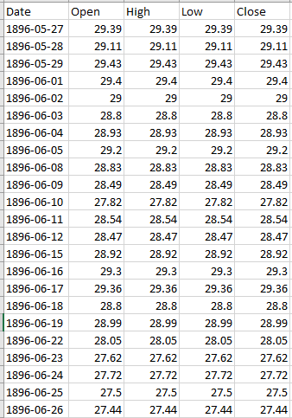
Daily Data

Slide 5
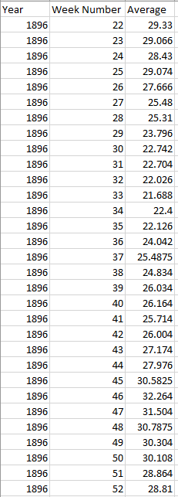
Weekly Data

Slide 6
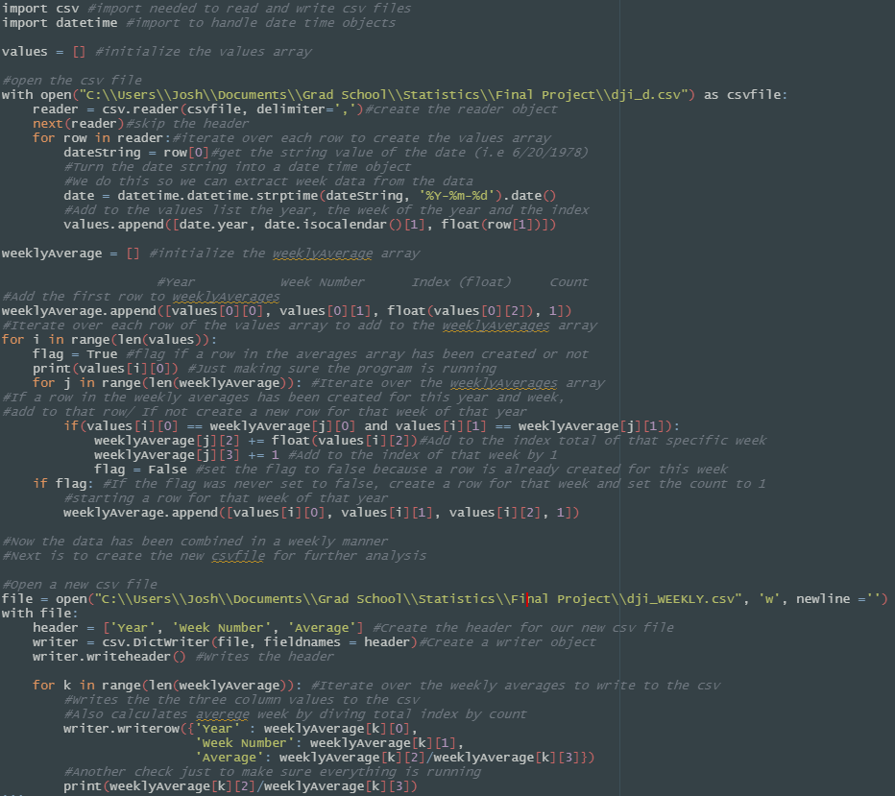
Python Script

Slide 7
ARIMA: Auto Regressive Integrated Moving Average
Four Steps:
Identification: Find the best values reproducing the time series variable to forecast.
Analysis and Differentiation: Study the time series, in our study we will use different statistical tools such as ACF and PACF tests.
Adjust the Arima Model: Extract and determine coefficients and adjust the model.
Prediction: Once the best model has been selected, we can make a forecast based on probabilistic future values.

Slide 8
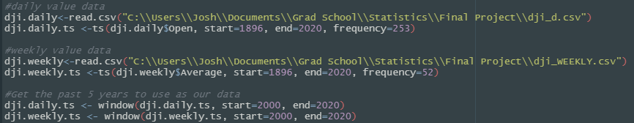
Arima: Read in the data
Below is the r code to read in the data and set the data to a time series.
Daily: frequency = 253, for the number of days the stock market is open a year.
Weekly: frequency = 52, 52 weeks in the year.
Note: It is very important to have the proper frequency.

Slide 9
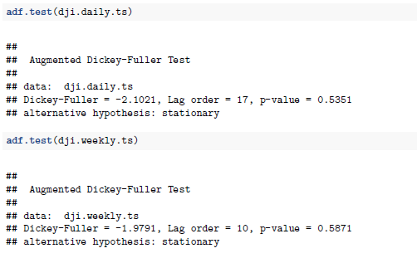
ARIMA: ADF tests
Run ADF on both Daily and Weekly data.
We run further analysis included in our detailed report

Slide 10
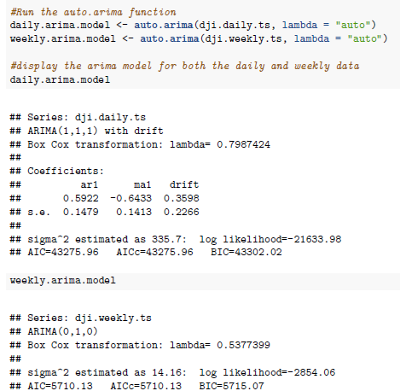
Run the auto.arima function
We use the auto.arima function which will automatically fit the best model to our data

Slide 11
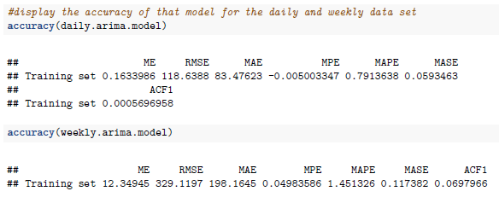
ARIMA: Testing the accuracy of our model
1. ME: Mean Error - average of all the errors in a set.
2. RMSE: Root Mean Squared Error - standard deviation of the residuals (prediction errors). Residuals
are a measure of how far from the regression line data points are.
3. MAE: Mean Absolute Error - the average of all absolute errors.
4. MPE: Mean Percentage Error - the computed average of percentage errors by which forecasts of a
model differ from actual values of the quantity being forecast.
5. MAPE: Mean Absolute Percentage Error - a statistical measure of how accurate a forecast system is.
It measures this accuracy as a percentage.
6. MASE: Mean Absolute Scaled Error - a scale-free error metric that gives each error as a ratio compared
to a baseline’s average error.
7. ACF1: Autocorrelation of errors at lag 1 - the correlation between values that are one time period
apart. More generally, a lag k autocorrelation is the correlation between values that are k time periods
apart.

Slide 12
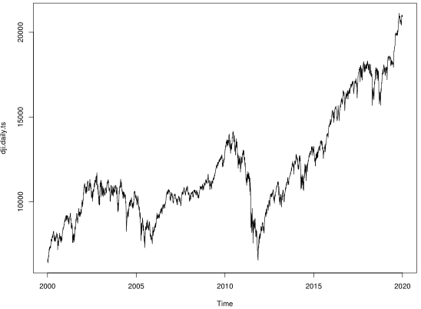
Arima: The daily Time series
This is the time series plot of the daily data we have been working with

Slide 13
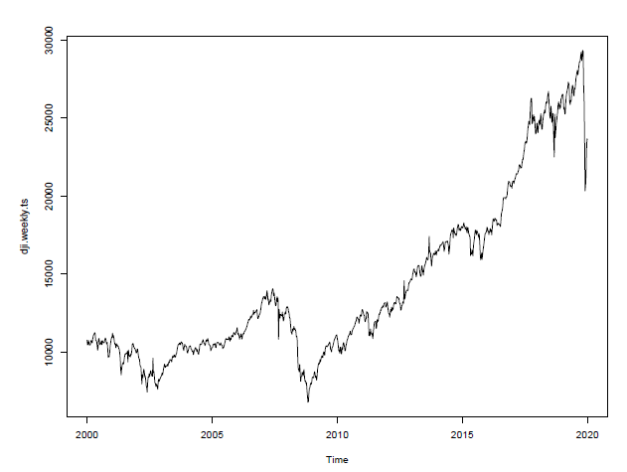
Arima: The weekly Time series
This is the time series plot of the weekly data we have been working with

Slide 14
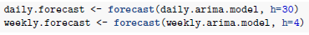
ARIMA: Forecast
This is the forecast method run on our Arima models for both the daily and weekly data.
H is the number of periods for forecasting.
Daily: we are forecasting 30 days in the future.
Weekly: we are forecasting 4 weeks in the future.

Slide 15
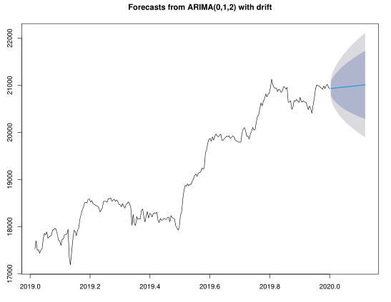
Arima: Daily plot of forecast
Our mean prediction shows the market should slightly increase over the next 30 days

Slide 16
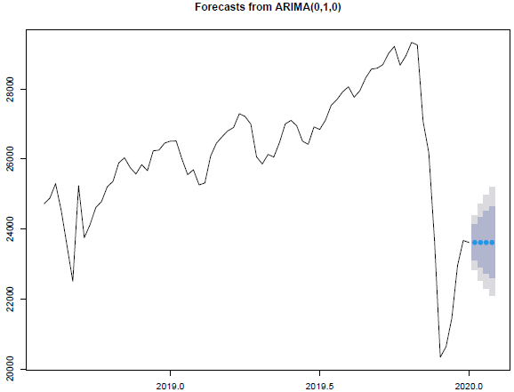
Arima: weekly plot of forecast
Our mean prediction shows the market should stay the same?
This predication is obviously incorrect.

Slide 17
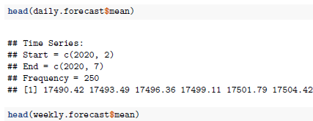
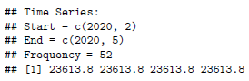
Arima: Mean prediction
Daily shows a slight increase in the mean prediction
Weekly shows the market staying the same over time. (Something possibly wrong here) – Proves this data set is not great for predication.

Slide 18
GARCH: Generalized Autoregressive Conditional Heteroskedasticity model
The Generalized Autoregressive Conditional Heteroskedasticity model have a foundation on making "Volatility clustering”.
Volatility is highly synonymous with risk. If we can effectively forecast volatility then we will be able to price options more accurately and create more sophisticated risk management tools.
Heteroskedasticity happens when the standard deviations of a predicted variable, monitored over different values of an independent variable or as related to prior time periods, are non-constant.
Conditional heteroskedasticity identifies non-constant volatility related to prior period's (e.g., daily) volatility.

Slide 19
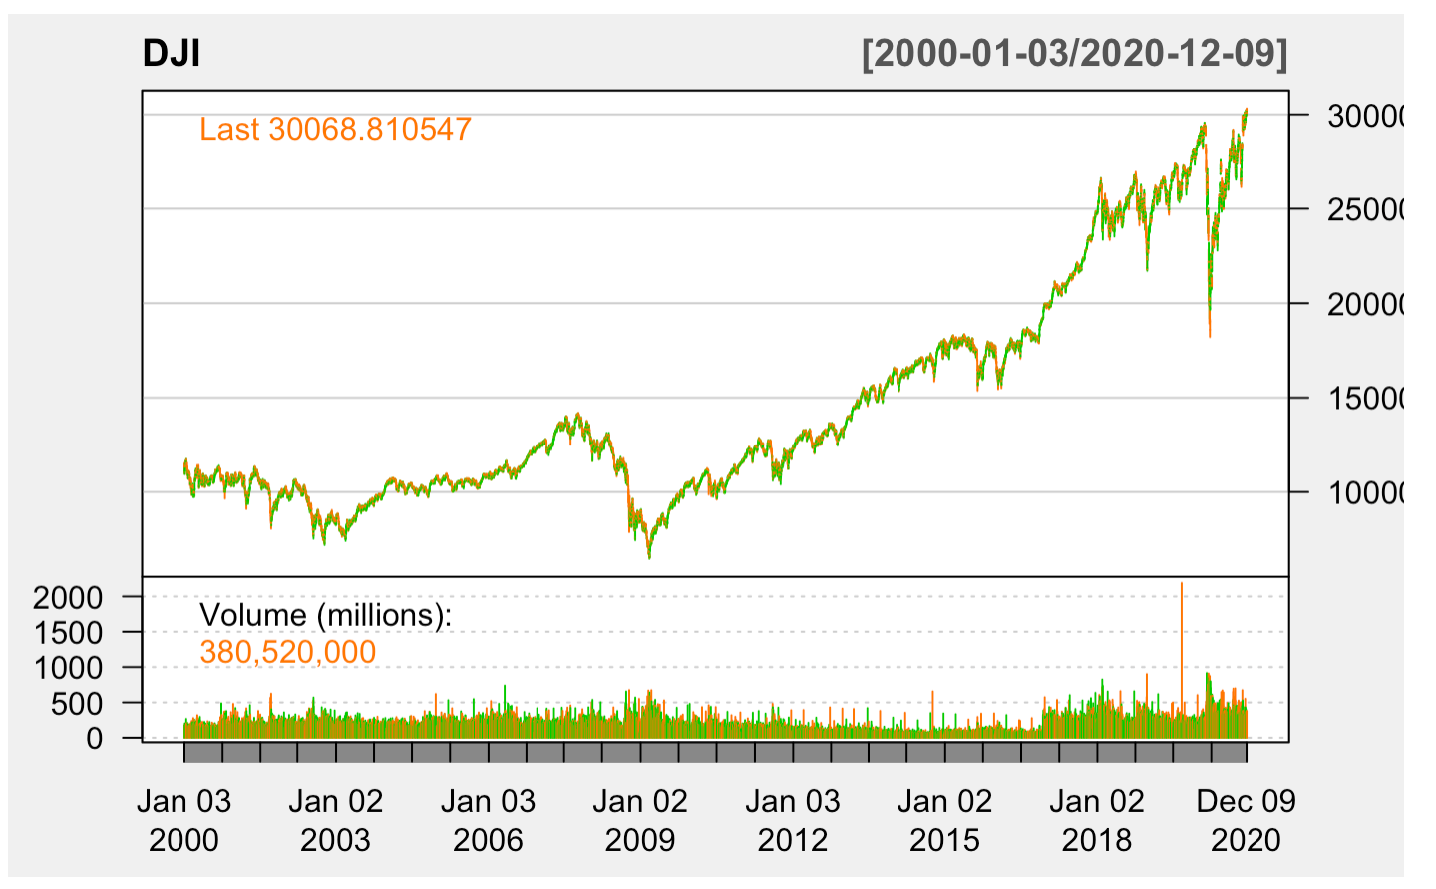
Time series plot of DJI data
Here’s the plot that shows the time-series for Dow Jones Industrial Averages data from the year 2000 to 2020.

Slide 20
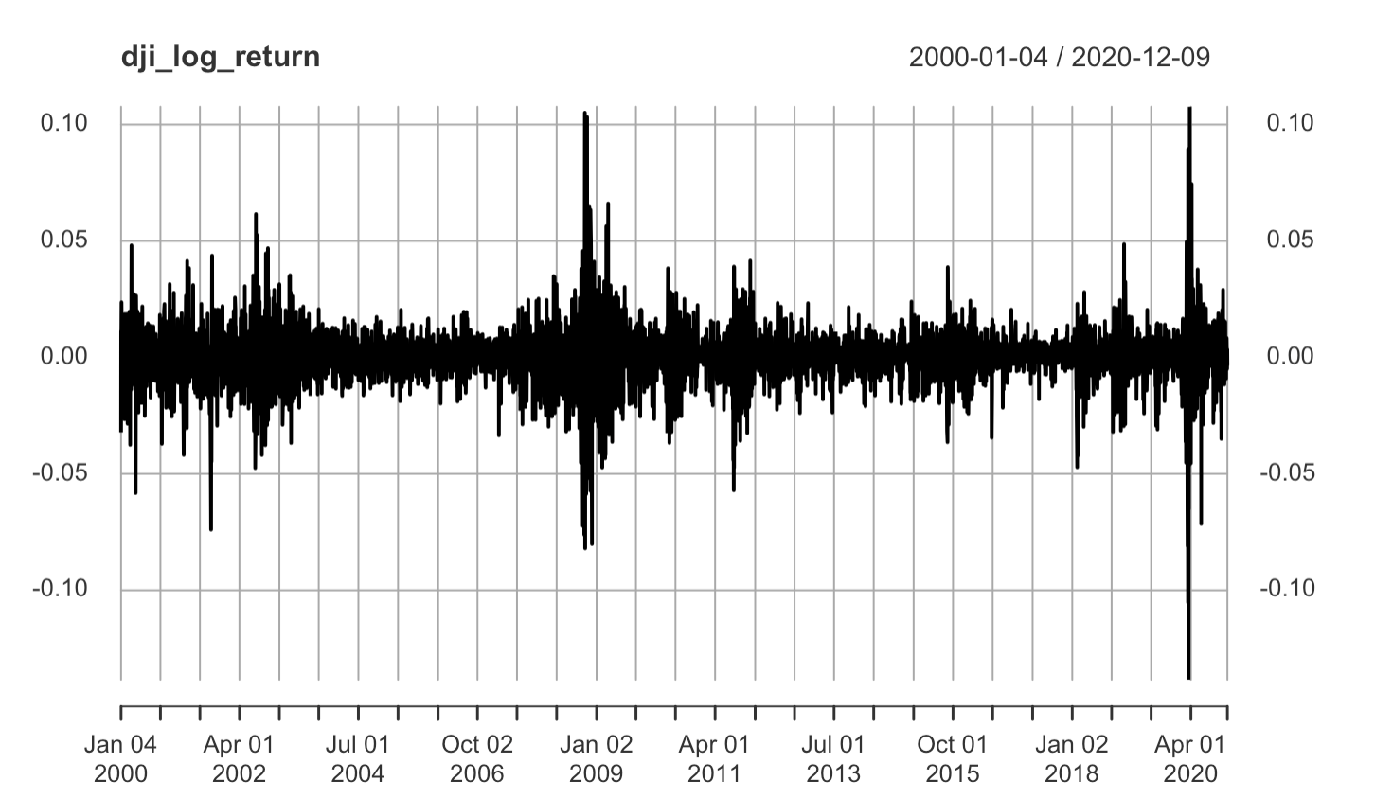
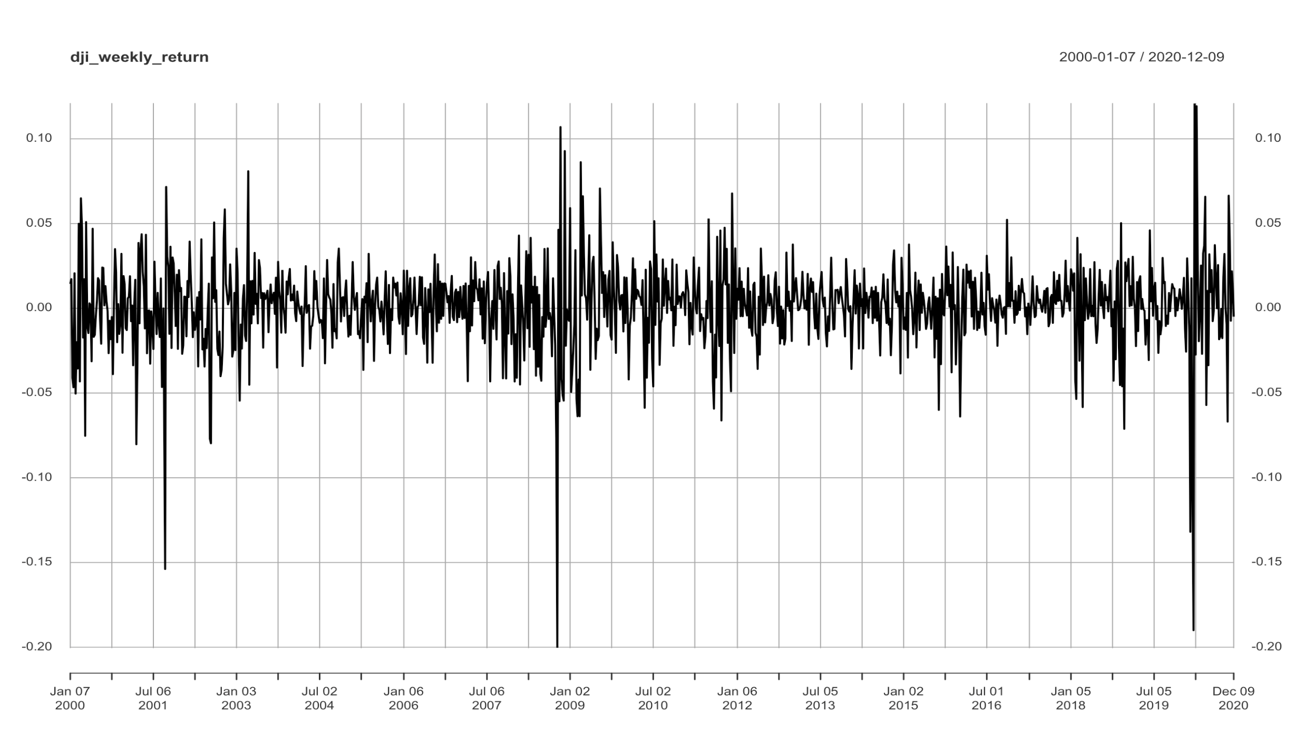
Log Returns plots
The plot on the top shows the daily log-returns for our data, and the plot on the bottom shows the weekly log-returns for our data.

Slide 21
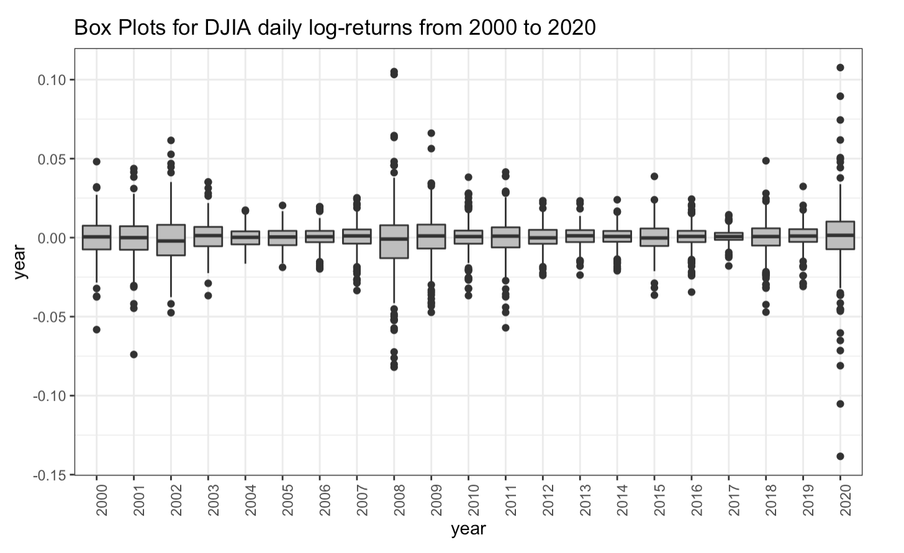
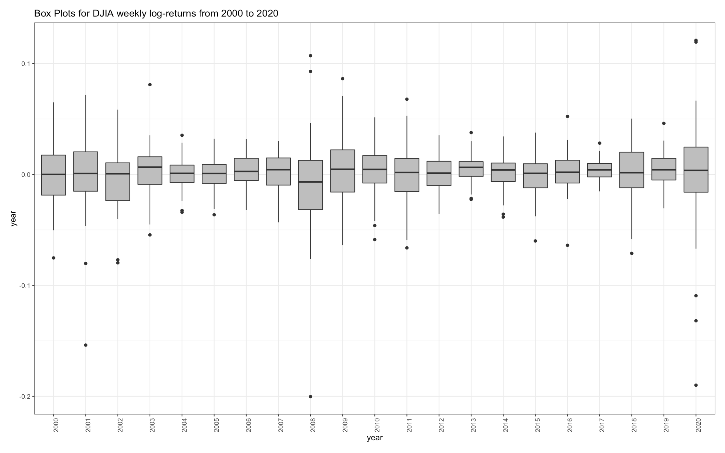
Boxplots

Slide 22
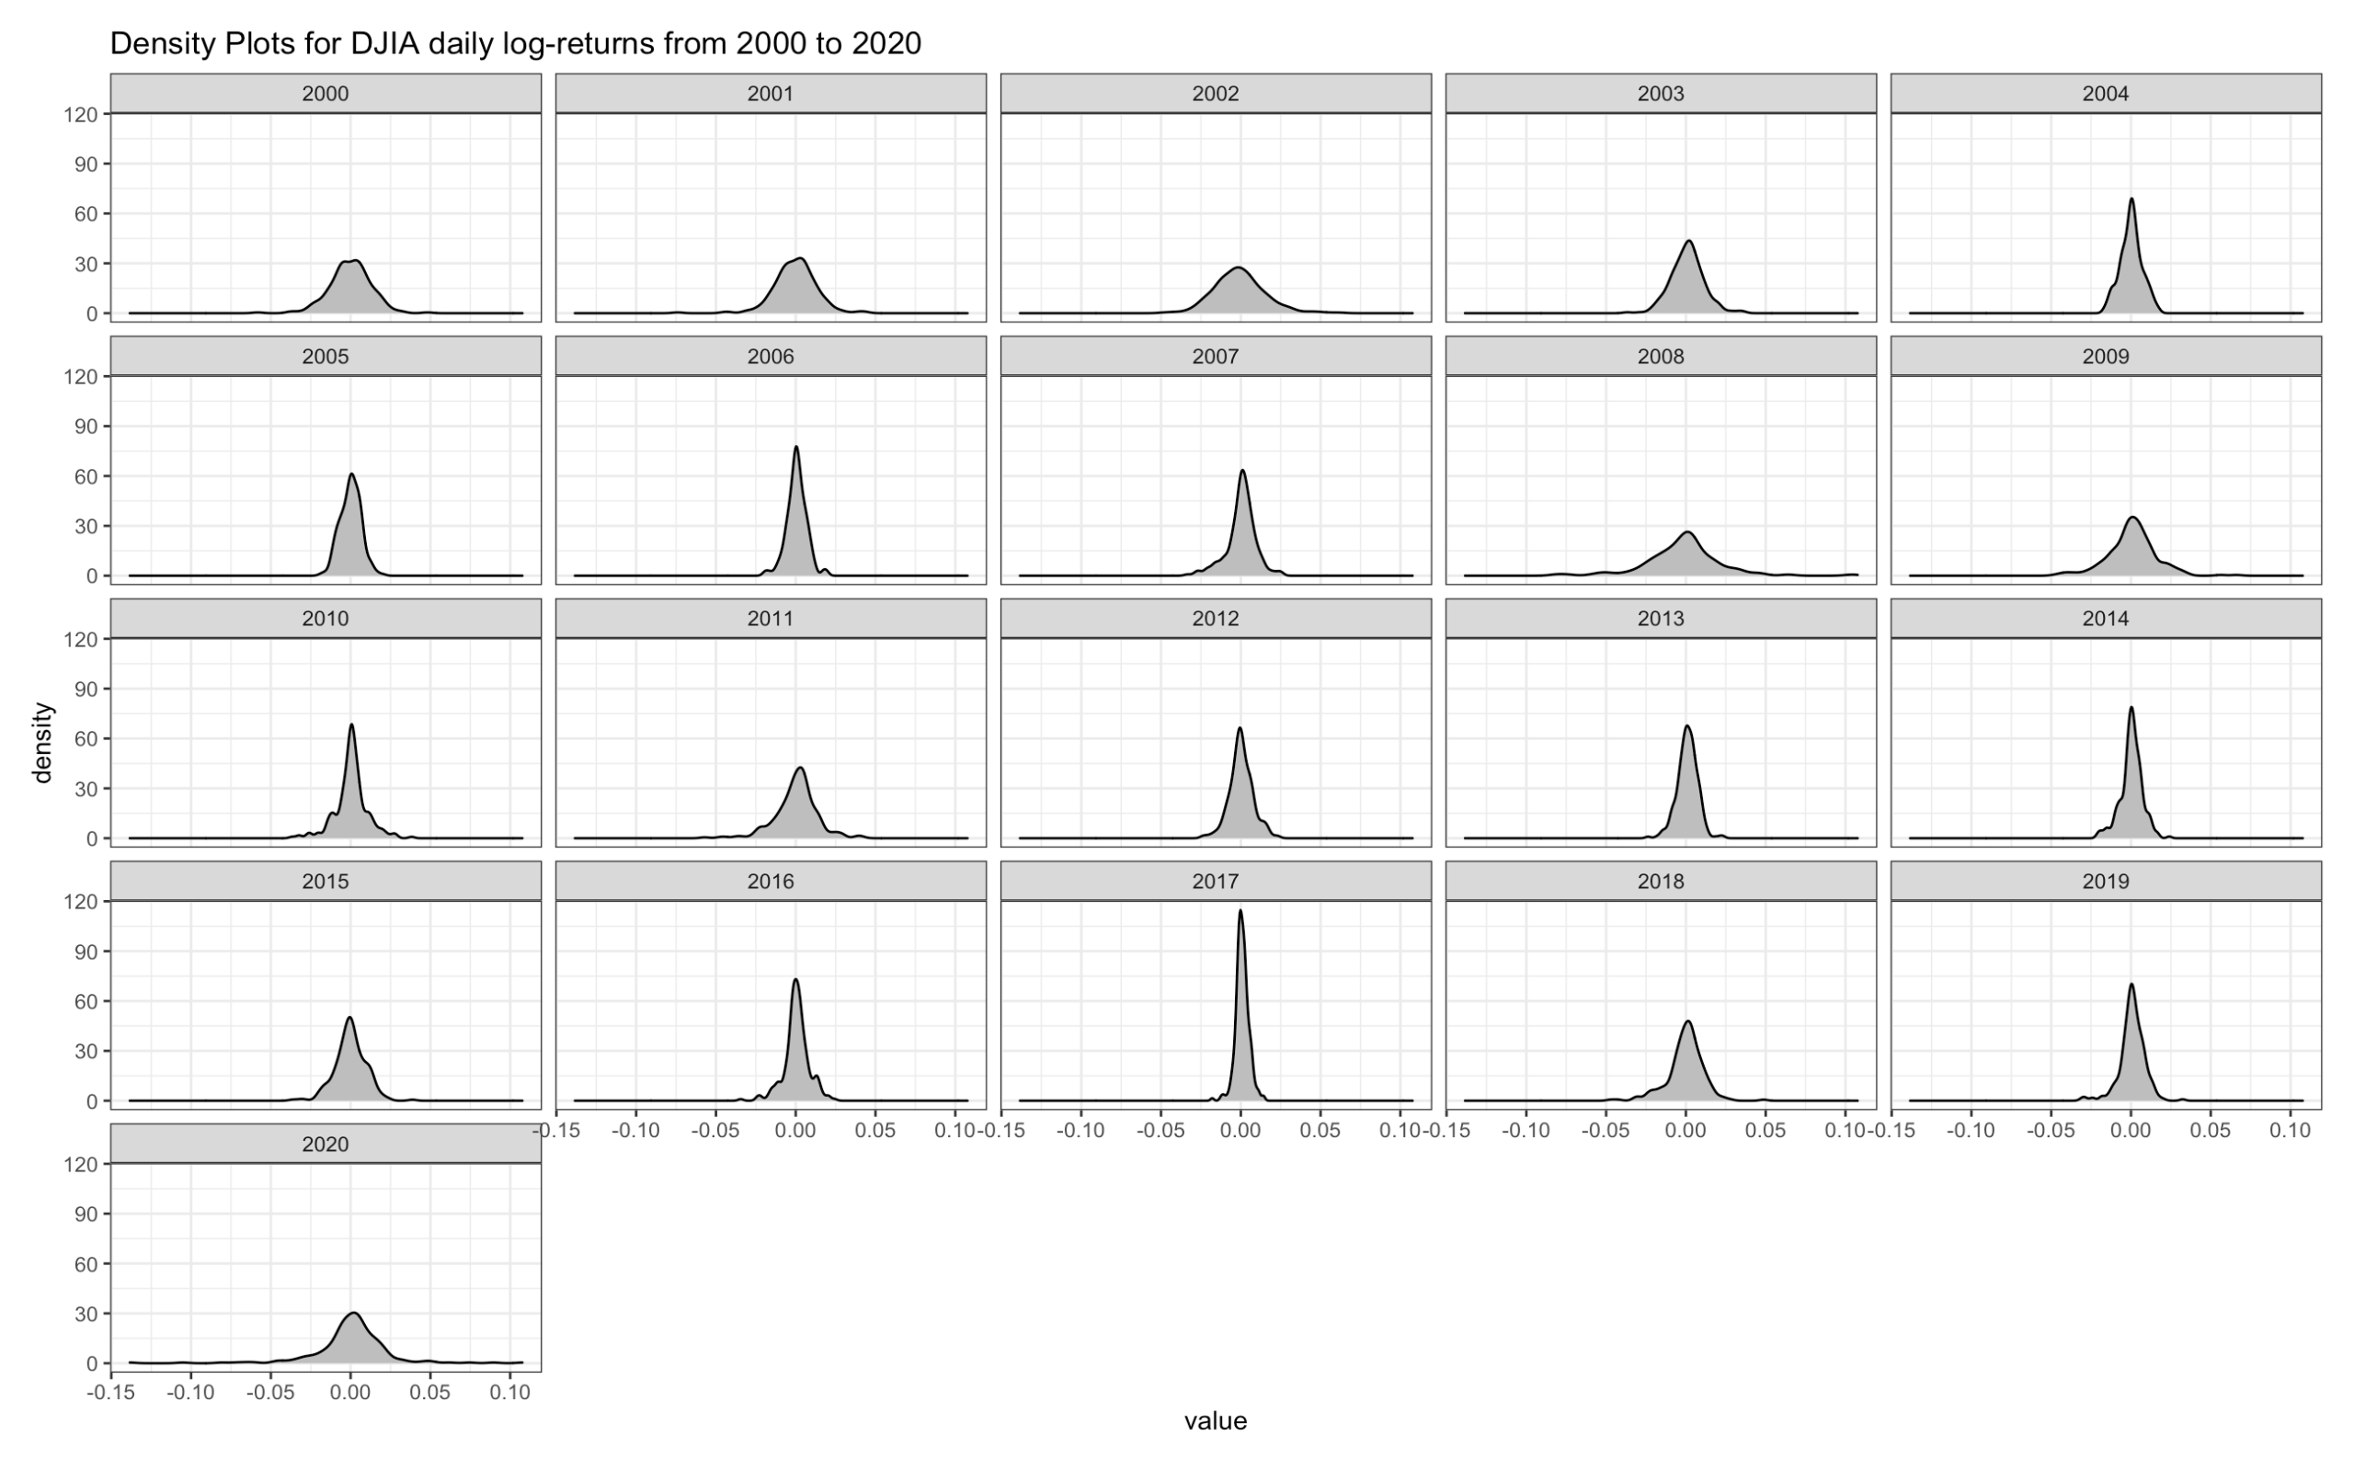
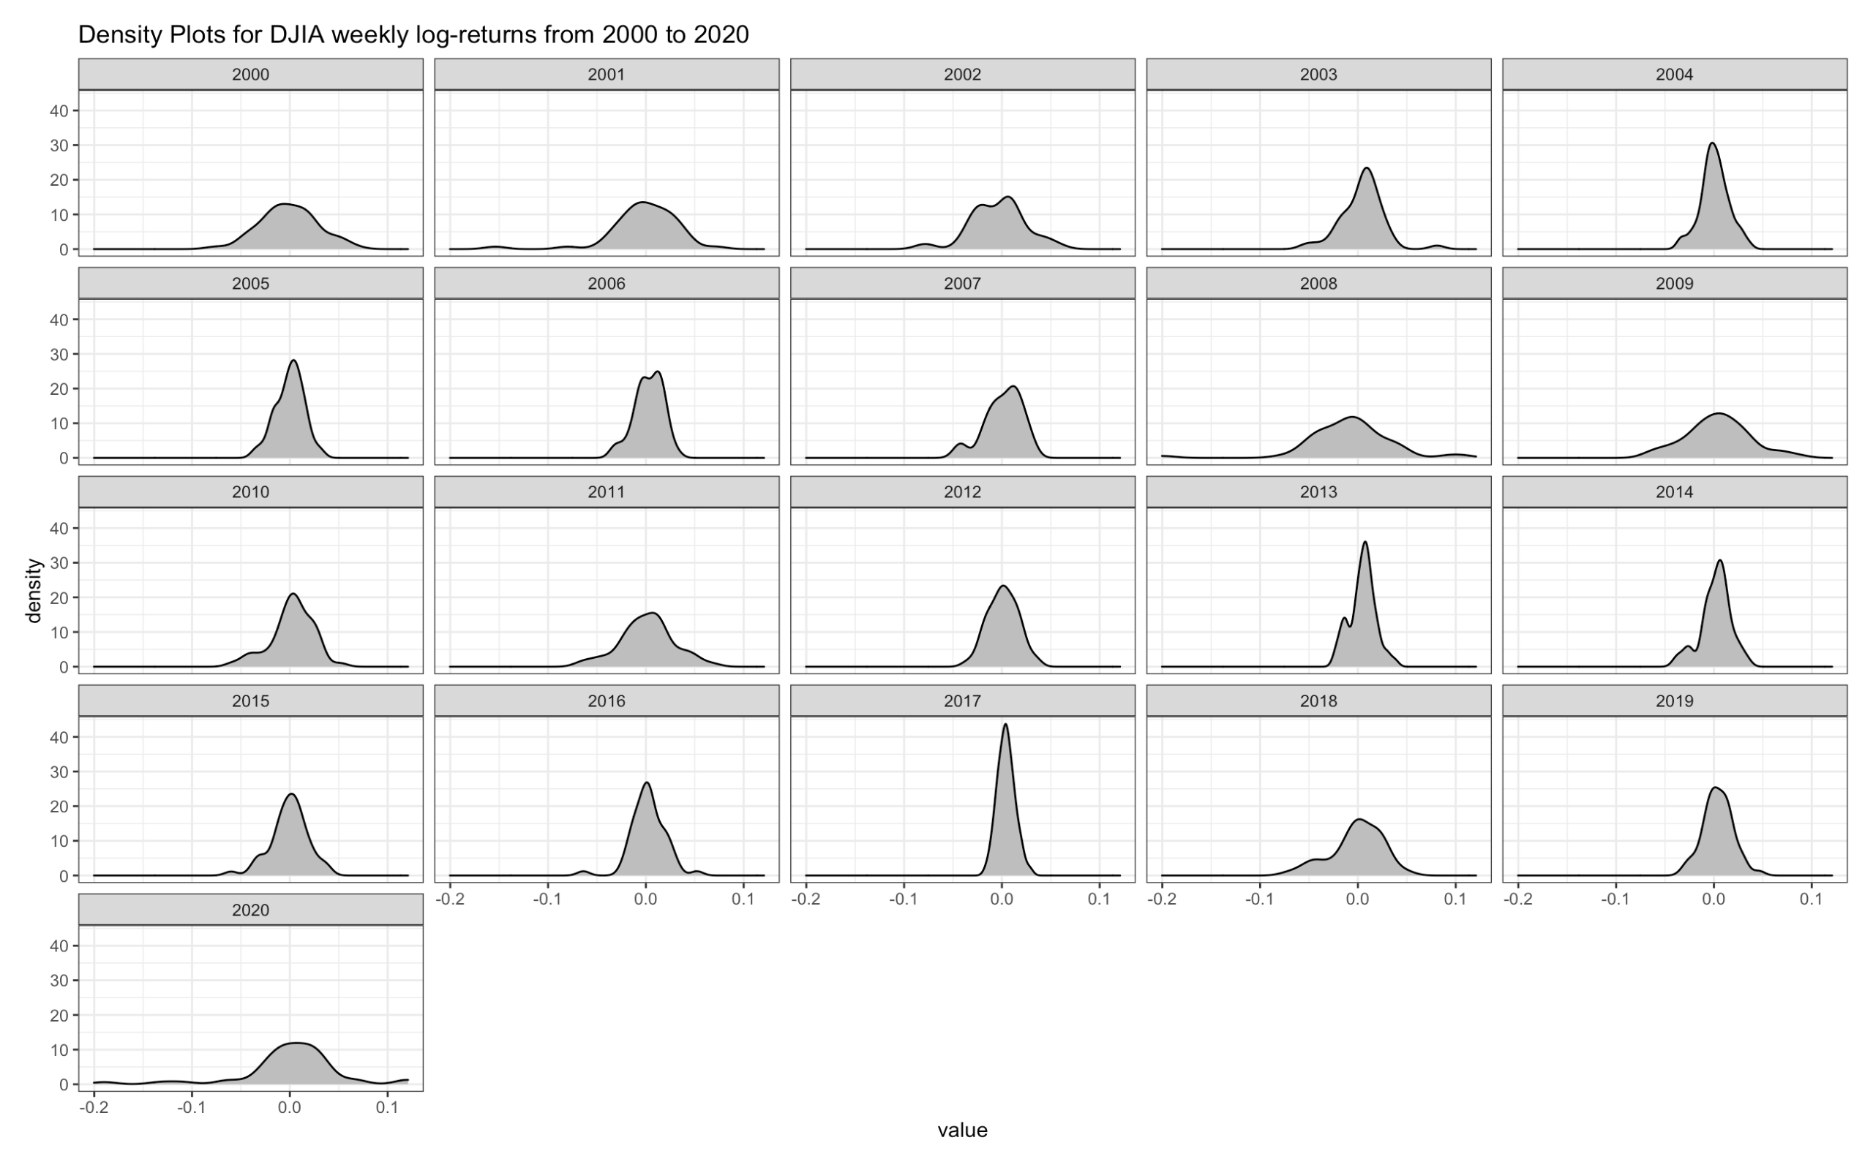
Density plots

Slide 23
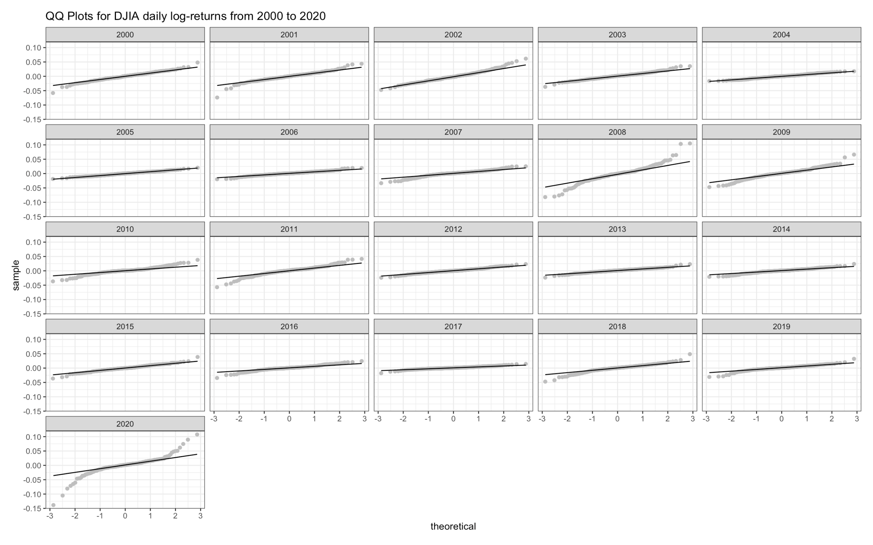
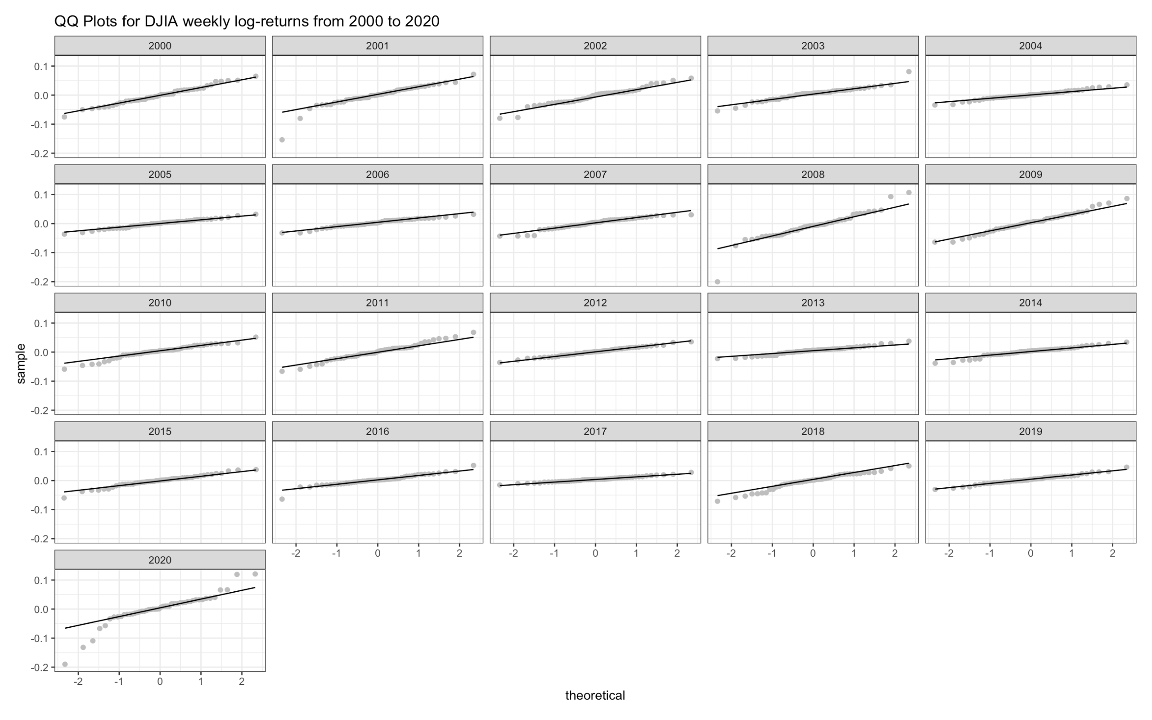
Q-Q plots

Slide 24
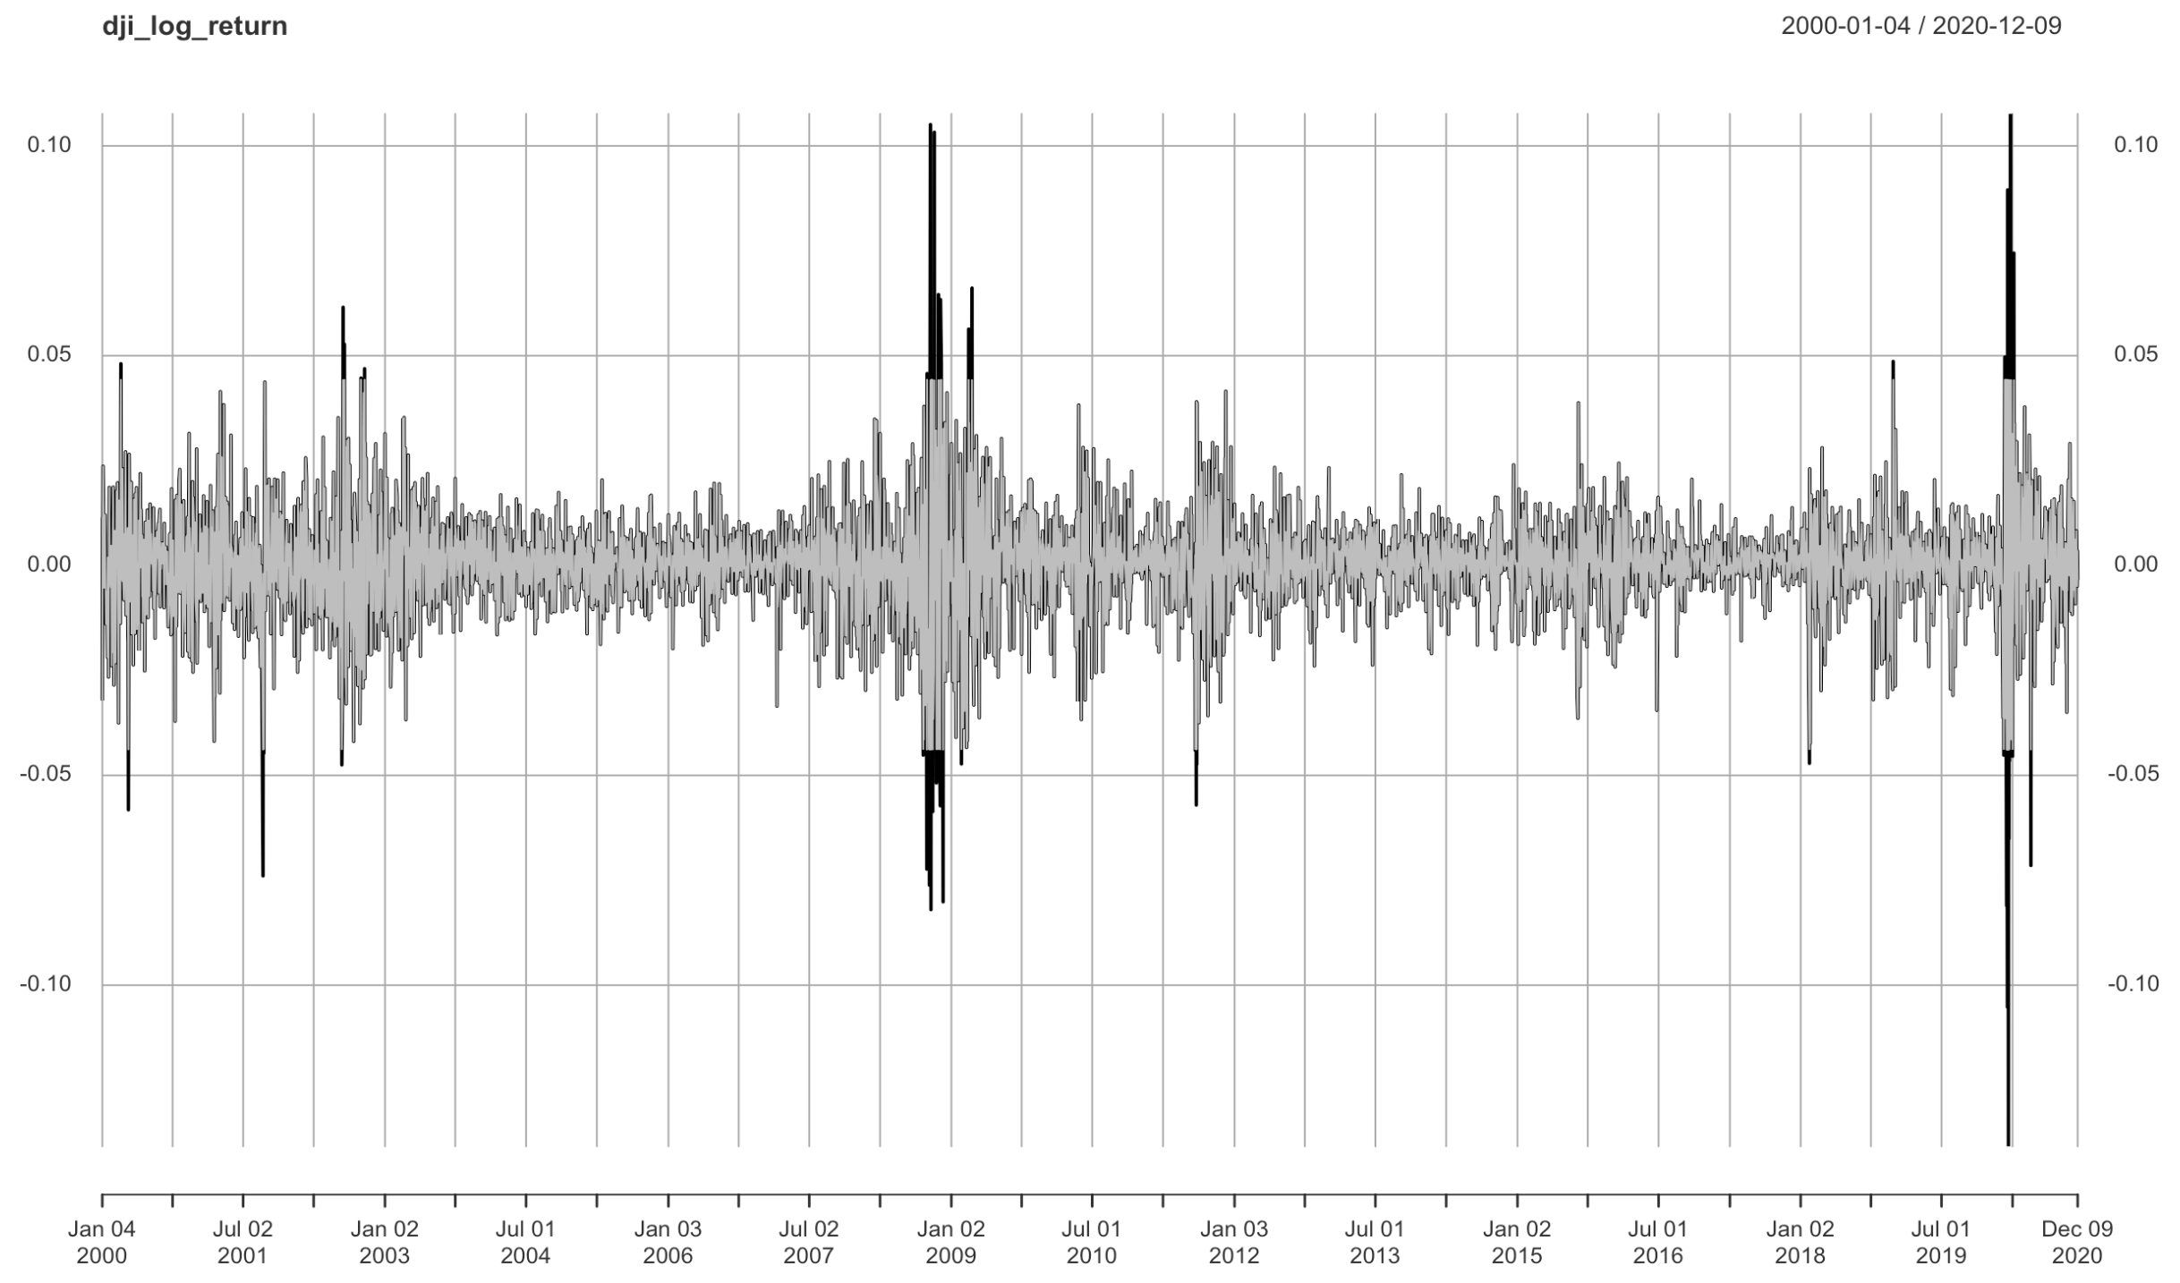
Outlier detection
The outliers in the daily log-returns graph are seen in the picture on the right.

Slide 25
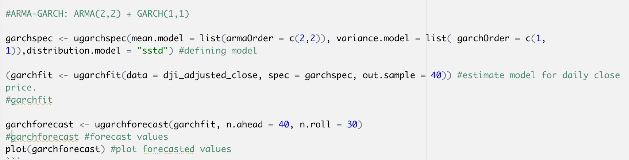
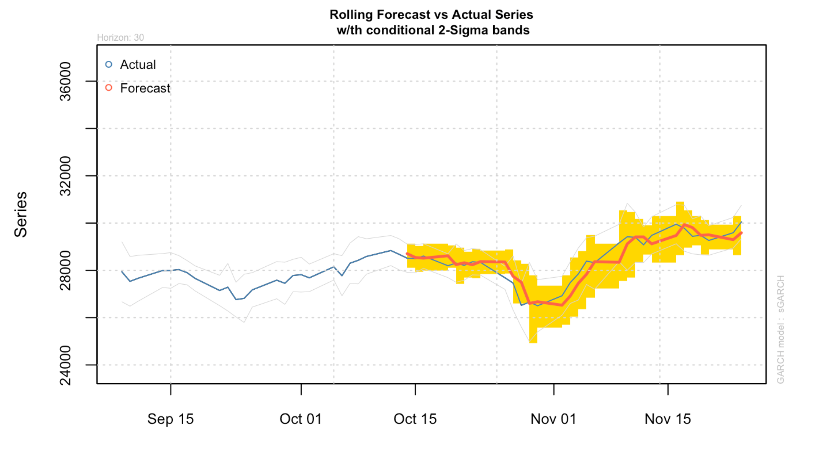
FORECASTING WITh GARCH MODEL
Here, is the prediction done by GARCH model on DJI data.
ARMA(2,2) + GARCH(1,1) models are used in order to forecast our predictions. Here ARMA model is the mean model and GARCH is the variance model.
Here, we have taken testing size to be 40(out.sample = 40) and calculated the averages for the next 40 days(n.ahead = 40).

Slide 26
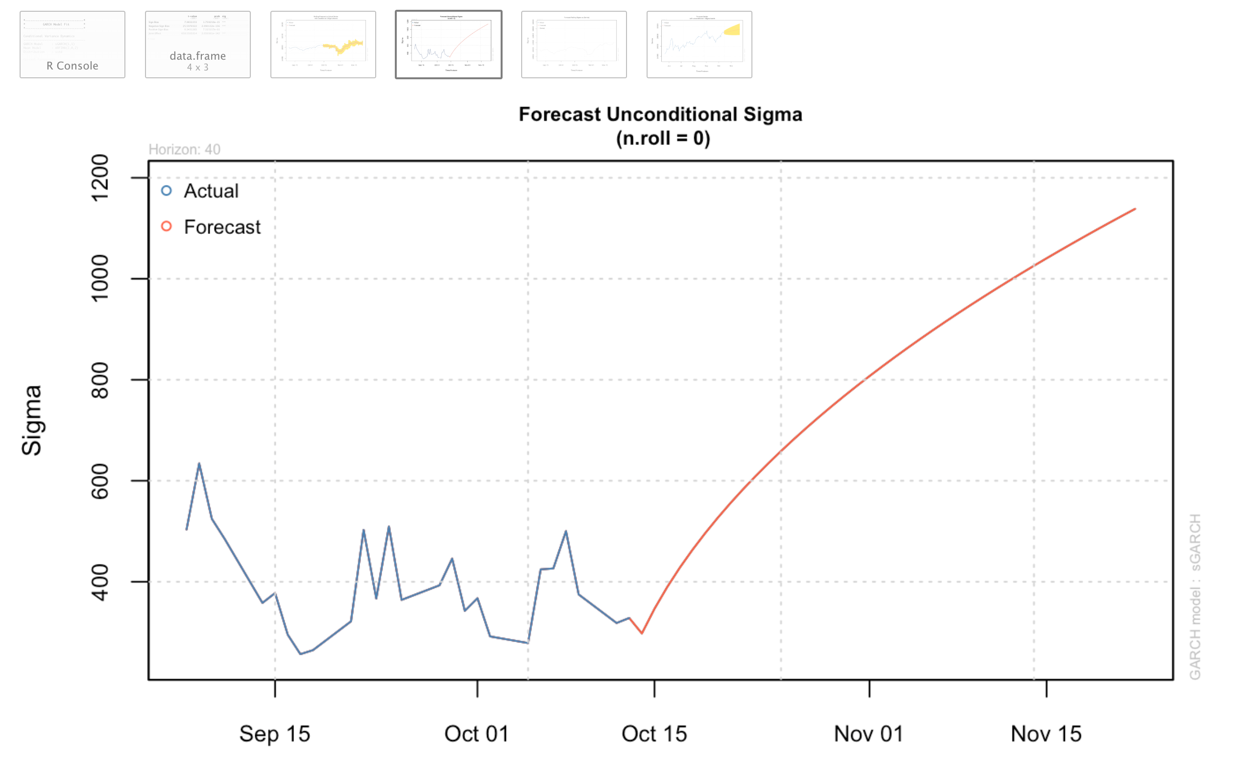
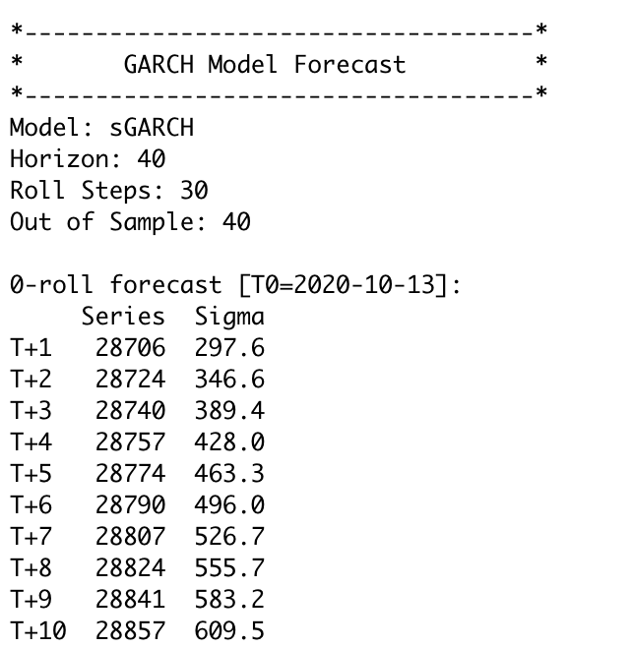
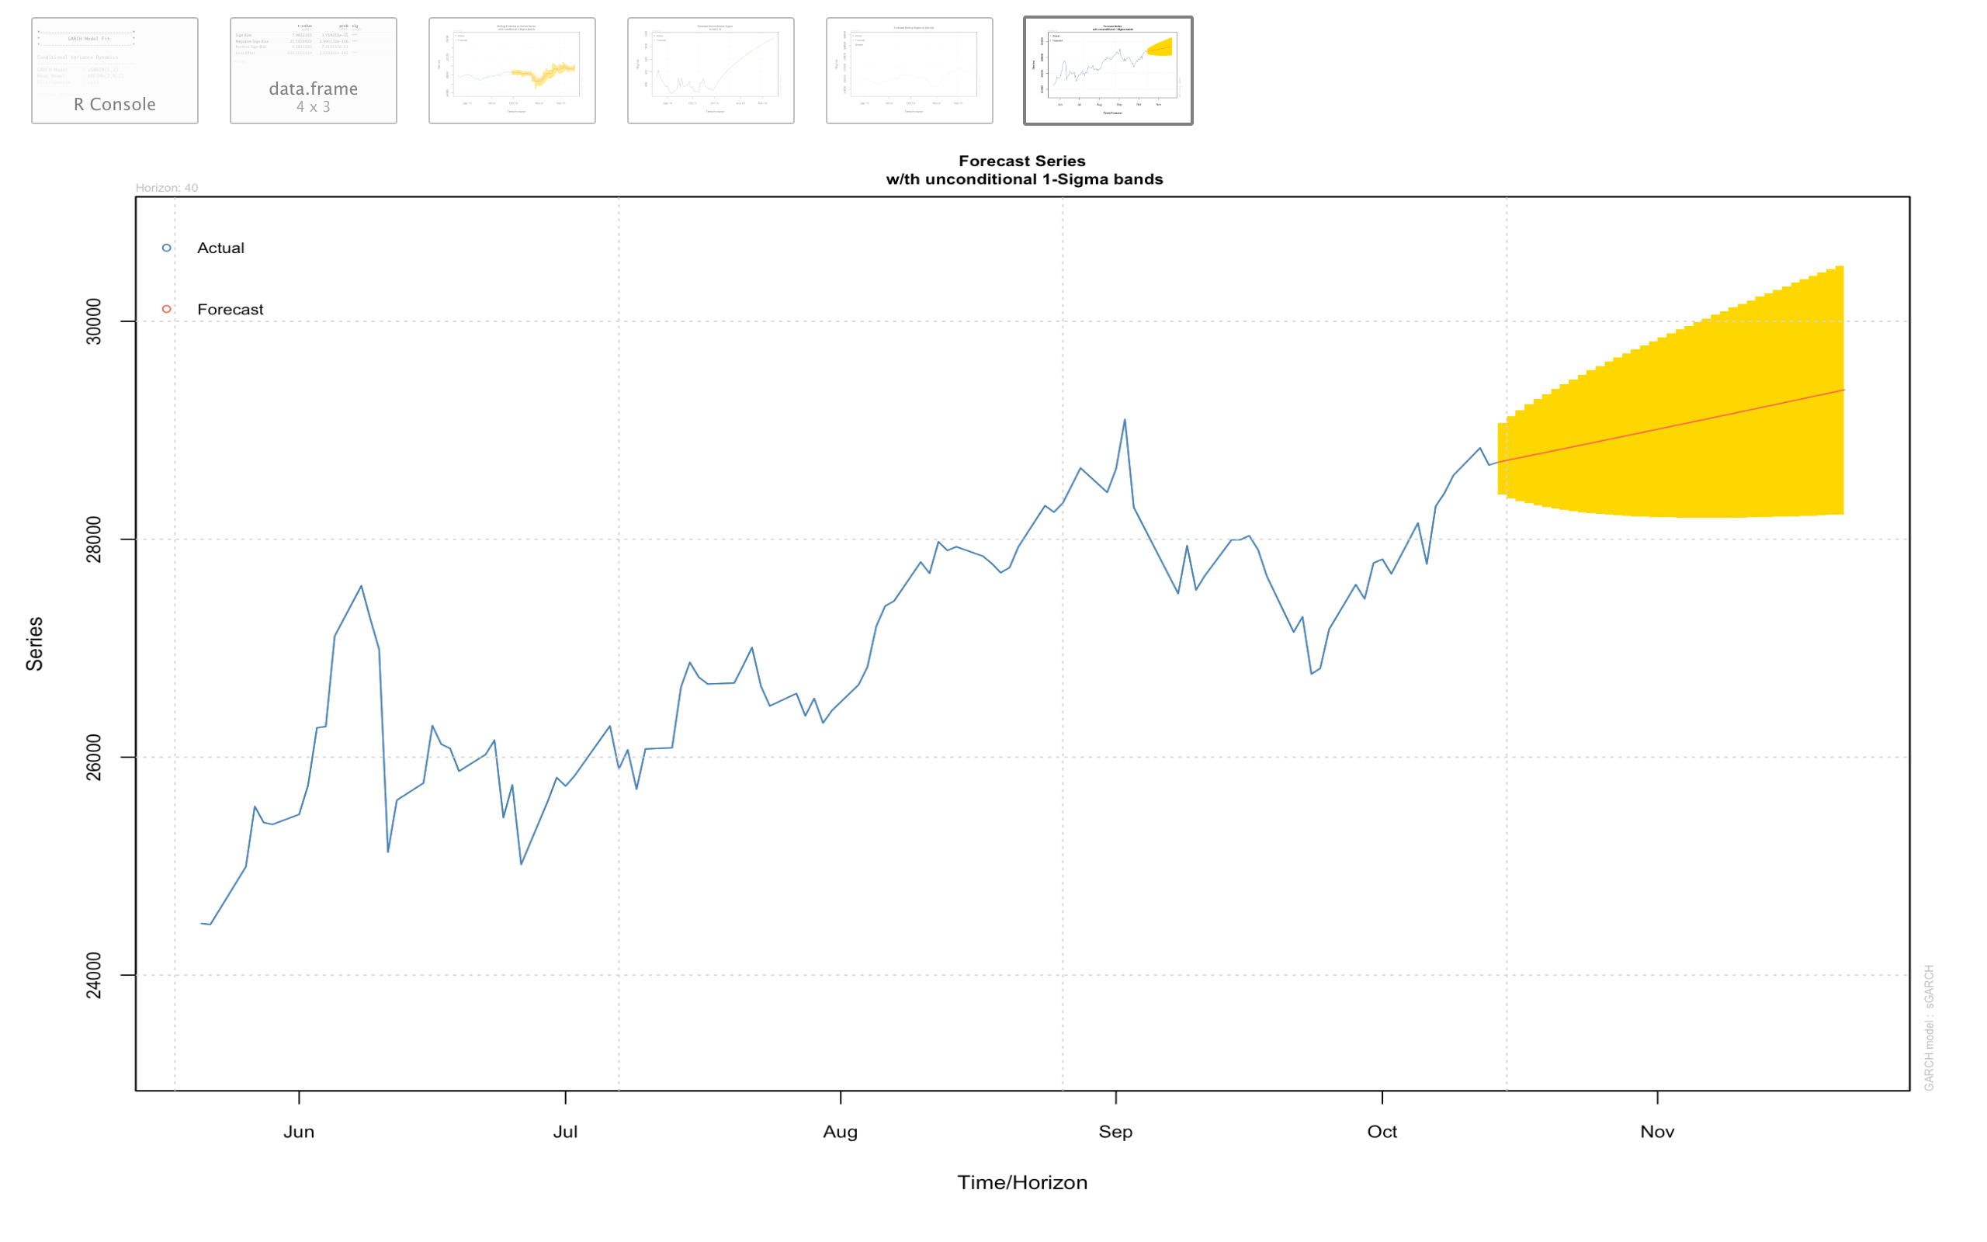

Slide 27
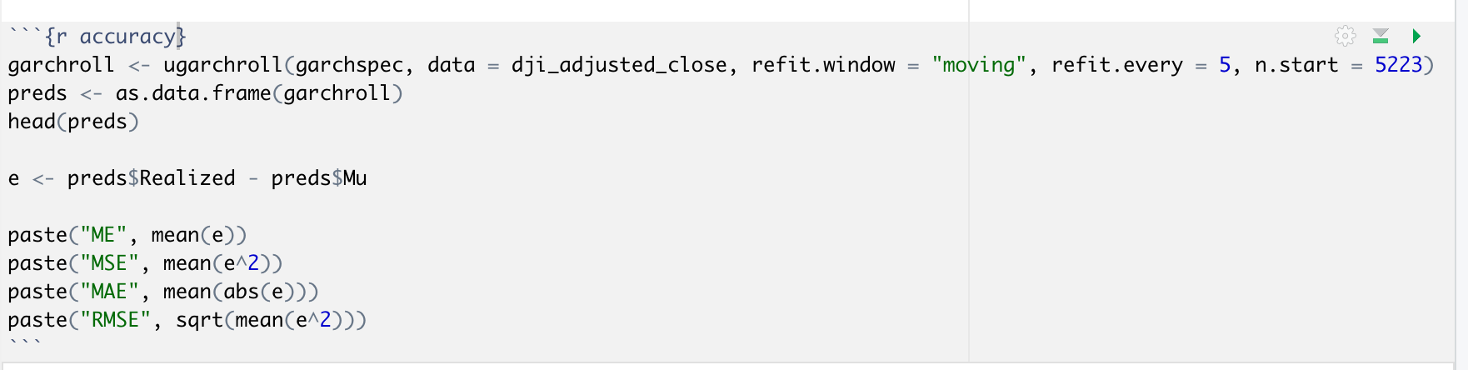
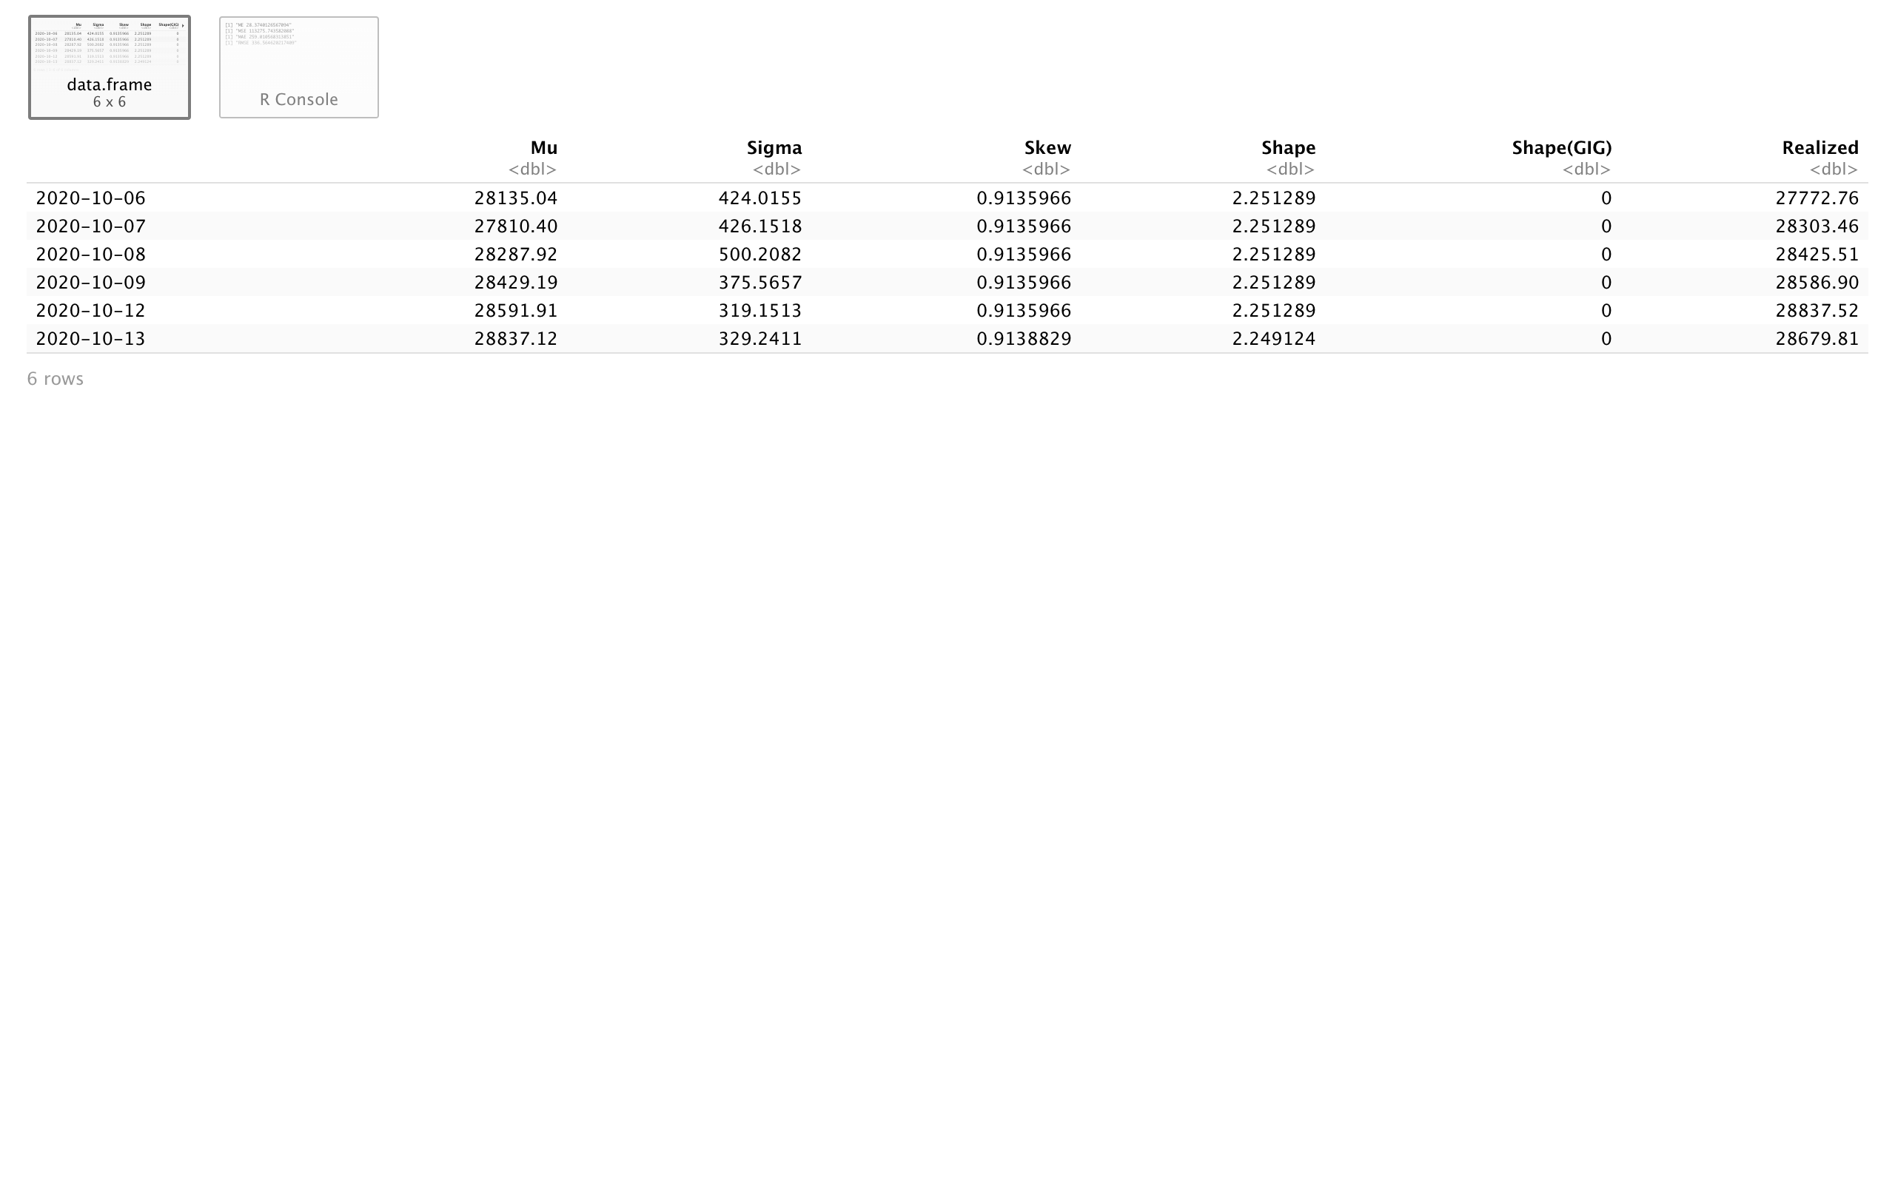
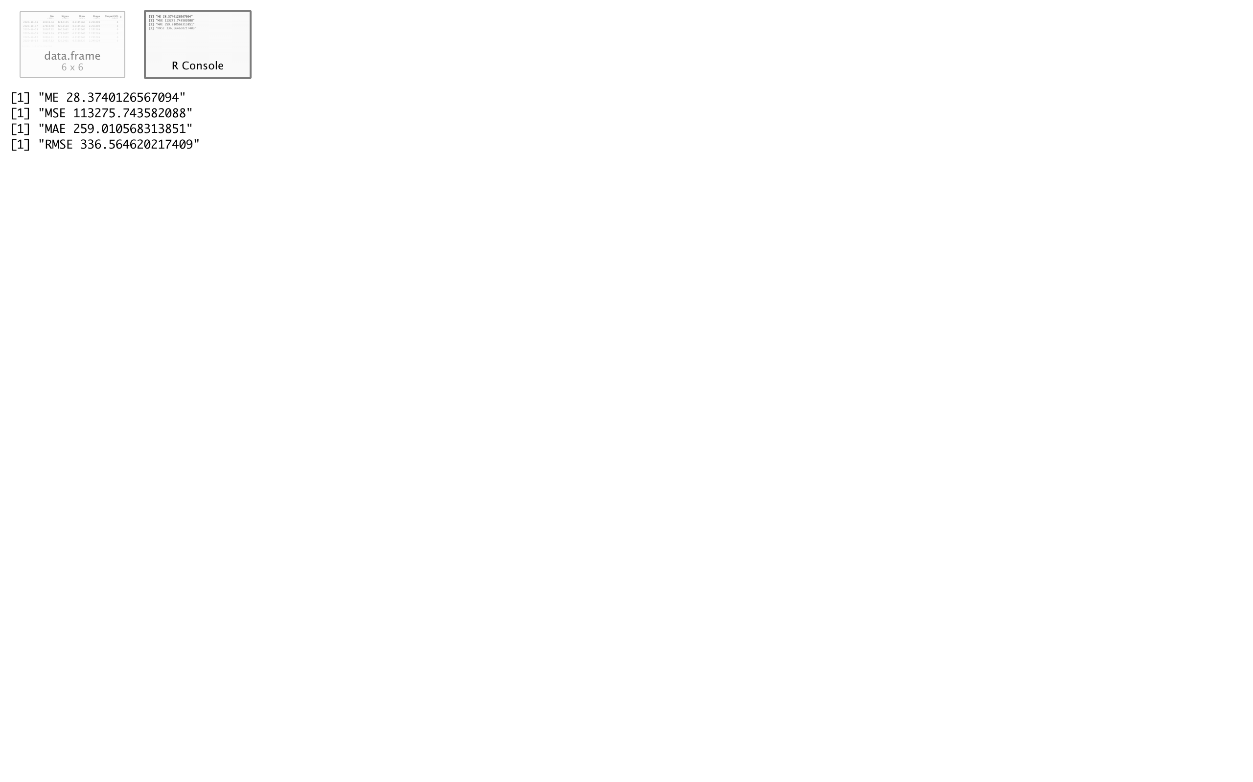
Accuracy of GARCH MODEL
The accuracy of GARCH model can be known by finding the mean errors like ME, MSE, MAE and RMSE.

Slide 28
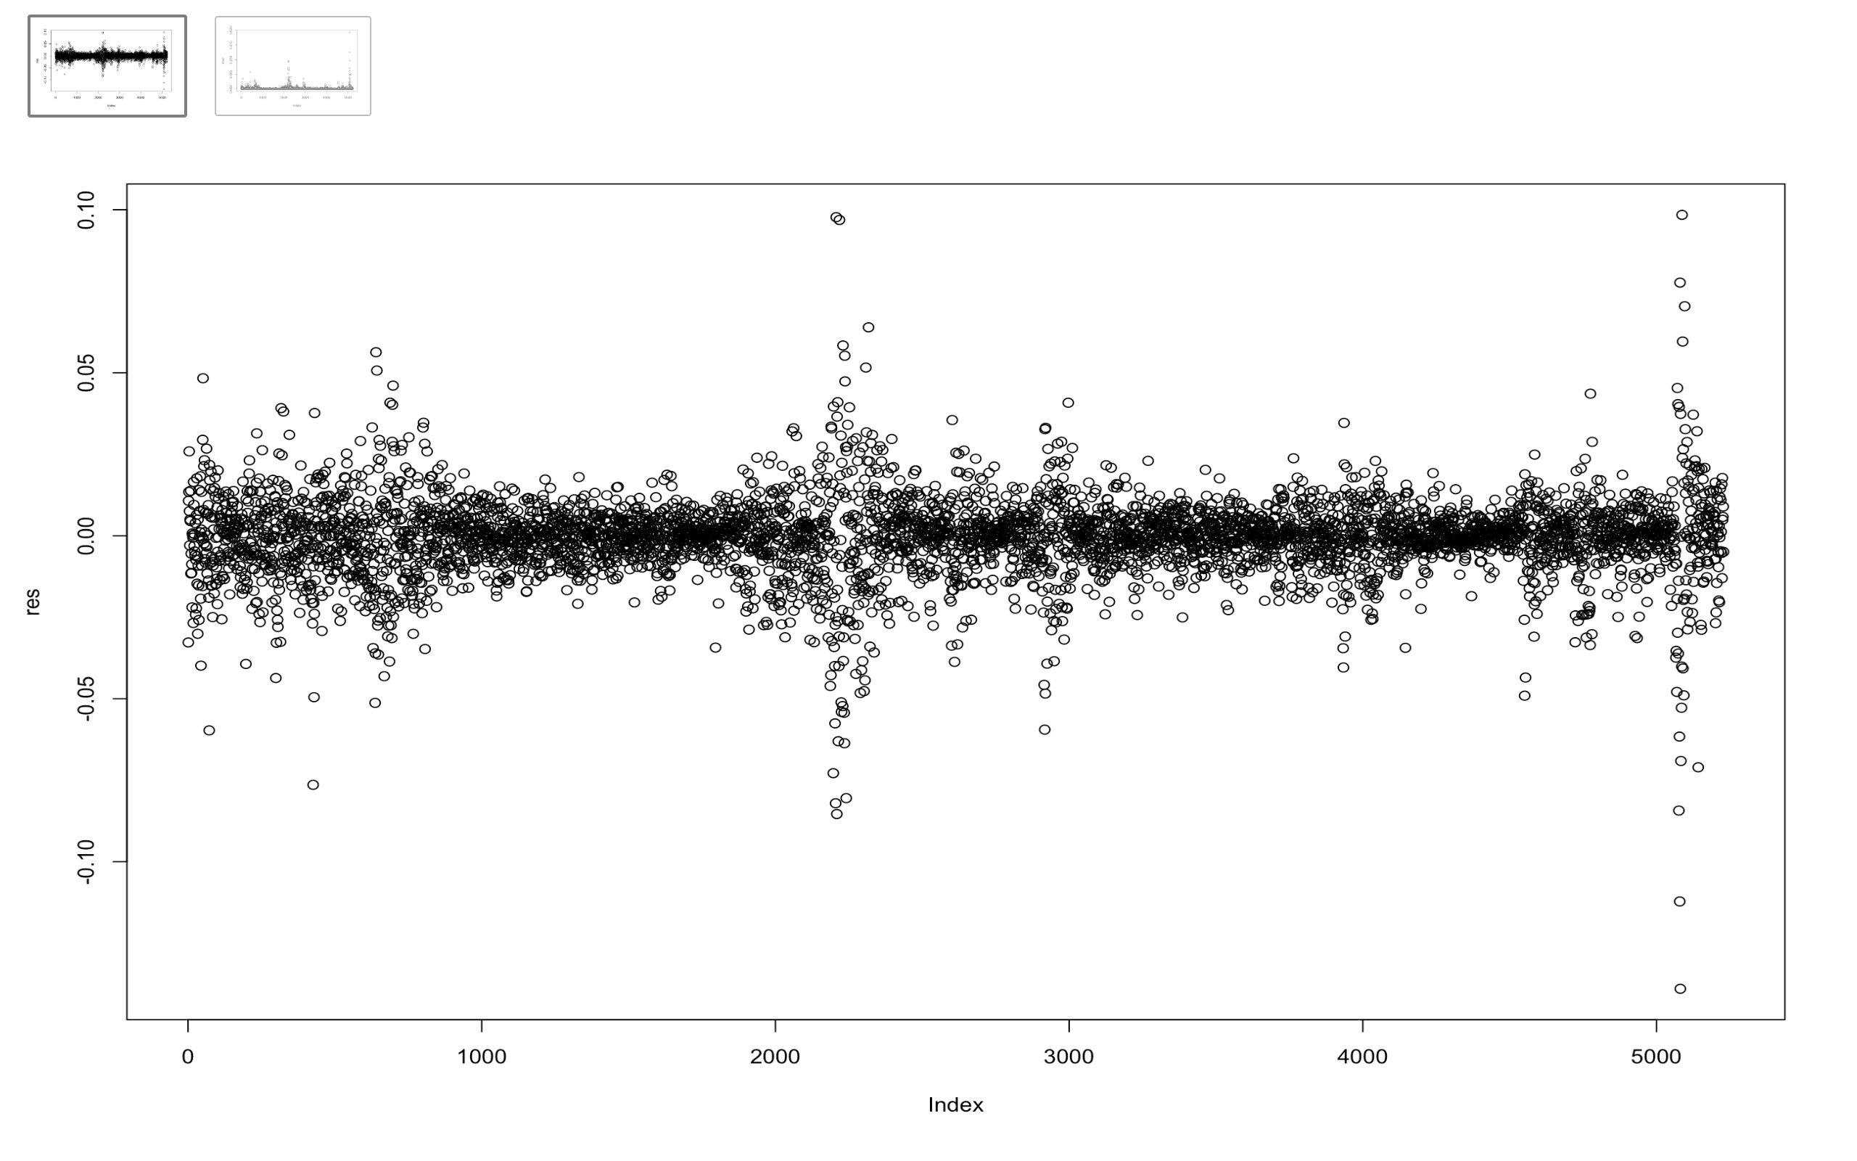
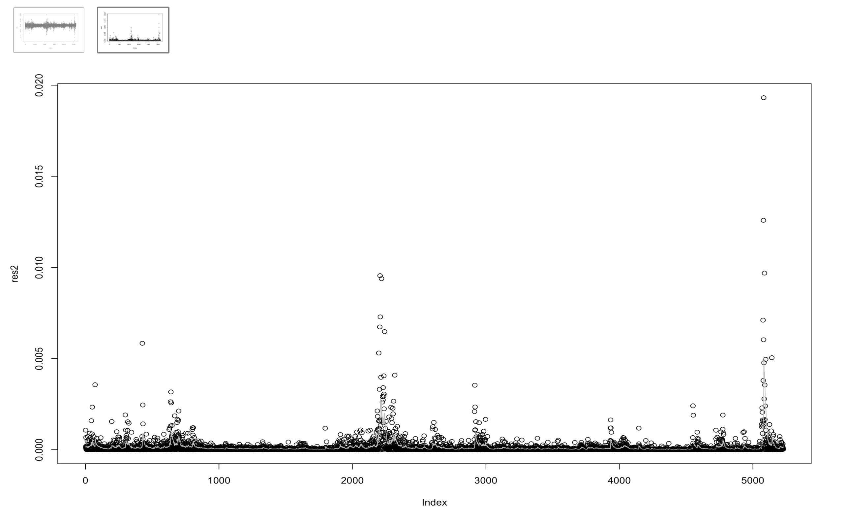
Residuals and Squared Residuals
The plots show the residual plots.
The first graph is the residual plot with normal residuals after fitting the model.
The second plot is plot of the squared residuals and the estimated conditional variance.

Slide 29
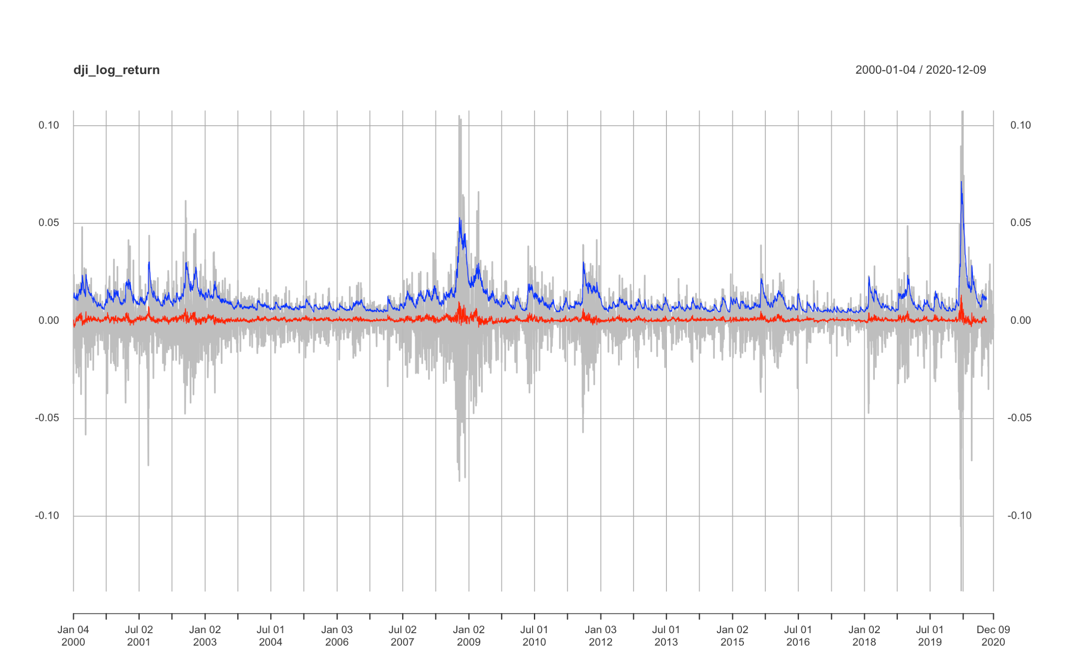
DJI Analyzed time series
Here is the plot showing the original DJIA log-returns time series with the mean model fit (red line) and the conditional volatility (blue line).

Slide 30
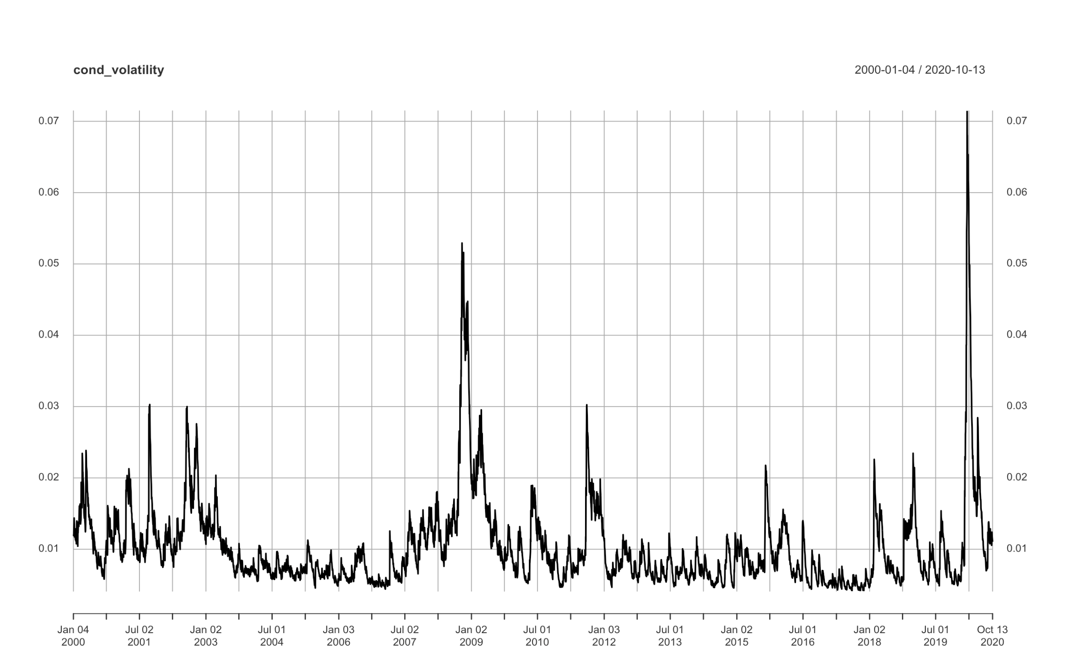
Conditional volatility series
Here is the plot of conditional volatility as a result of our GARCH model on log-returns.

Slide 31
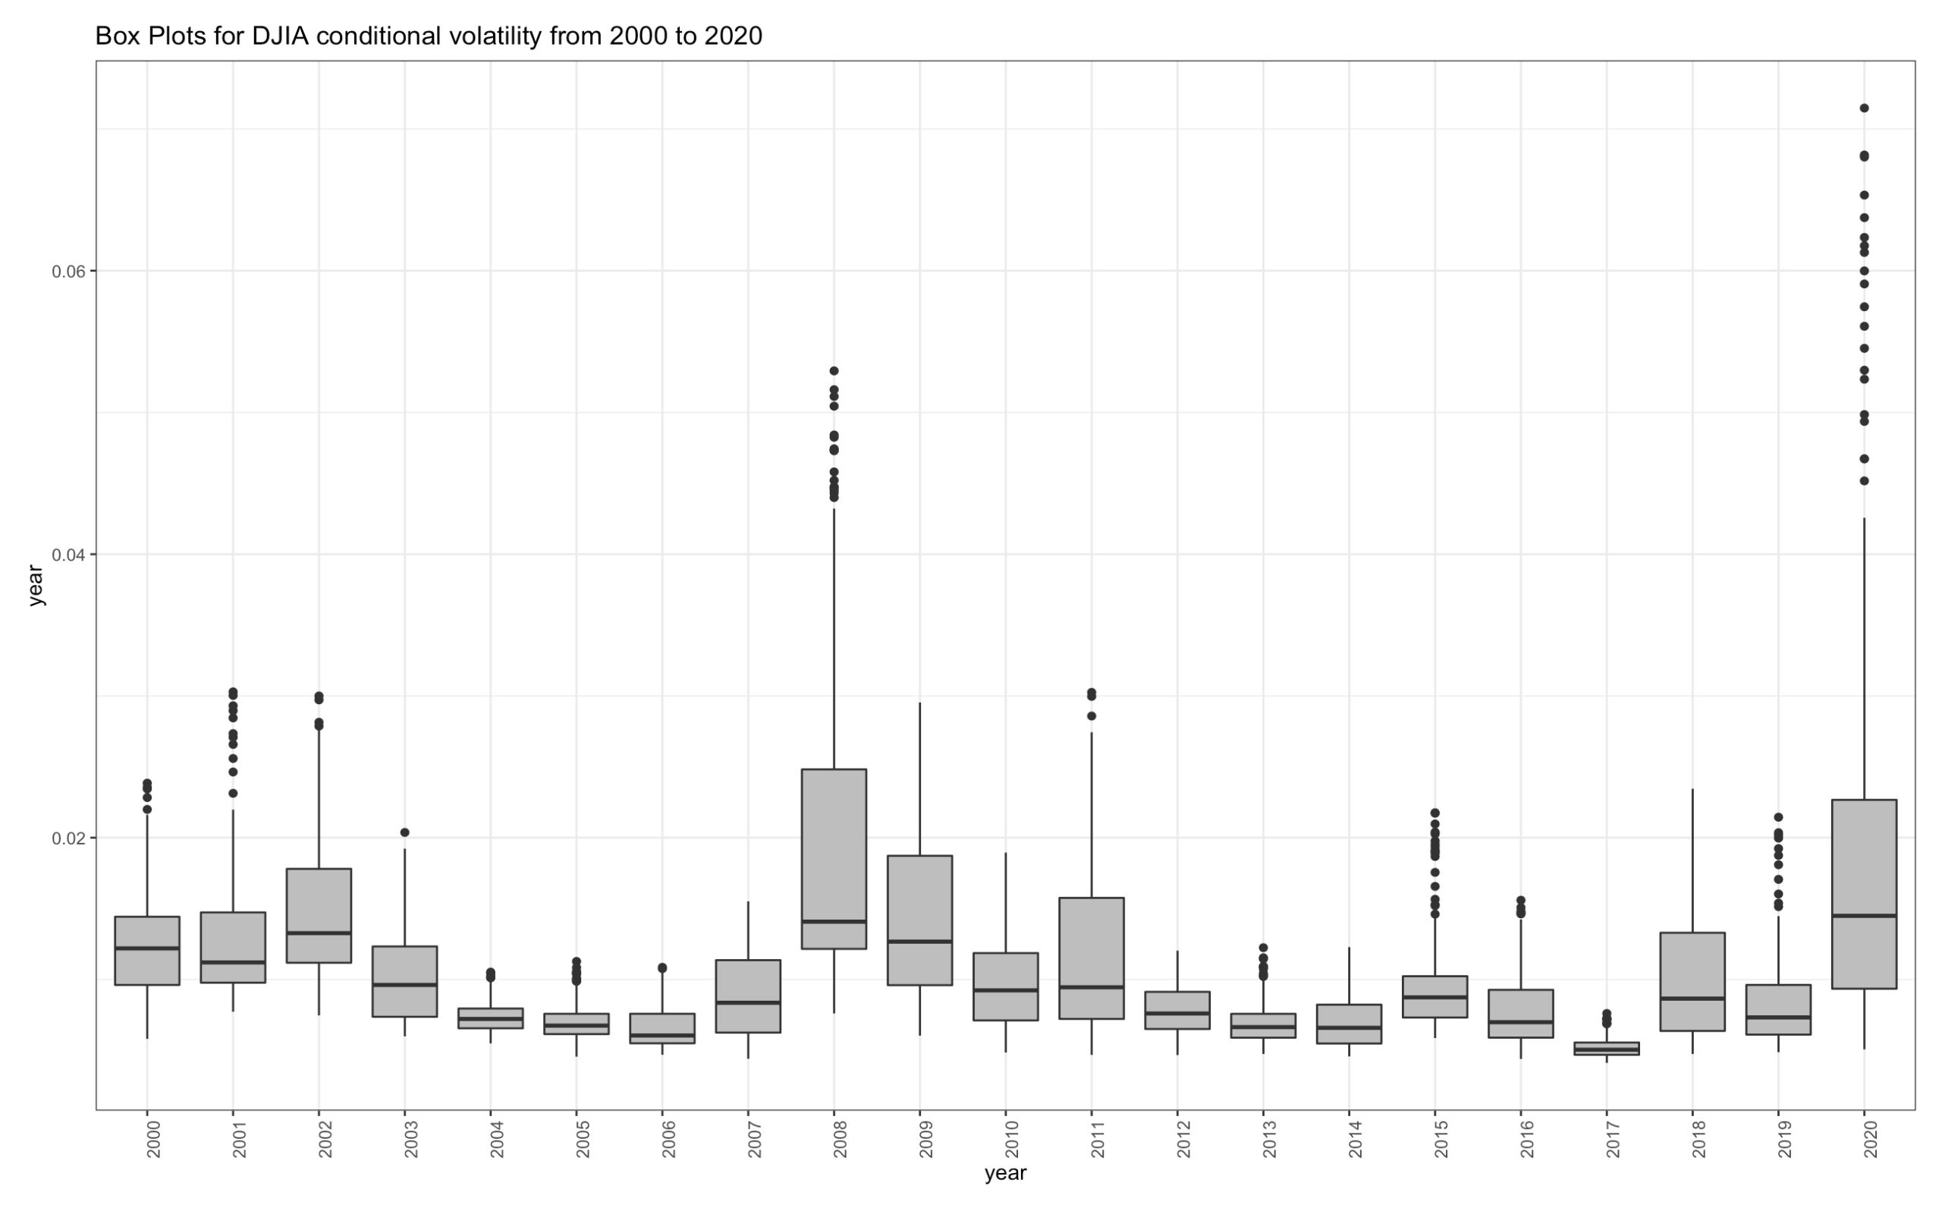
BOX-PLOT OF CONditional Volatility
Here is the plot of conditional volatility as a result of our GARCH model on log-returns.

Slide 32
Conclusion for GARCH MODEL
Here, we built ARMA-GARCH models, to obtain conditional volatility.
We saw that the conditional volatility changes within and between years. This shows that the volatility is an indicator of the amplitude of variations and is a basic measure of risk when applied to log returns of an asset.
The conditional volatility at time t is the volatility of a random variable given the knowledge of historical data up to time t-1. To compute the conditional volatility, we have to build a GARCH model.
Volatility has a wide range of applications in finance:
Options Pricing
Risk Management
Tradeable Securities
The clustering of volatility is based on the periods with relative calm movements and periods of high volatility. This behavior is very typical in the financial stock market data as we said and hence, GARCH model is a very good approach to minimize the volatility effect.

Slide 33
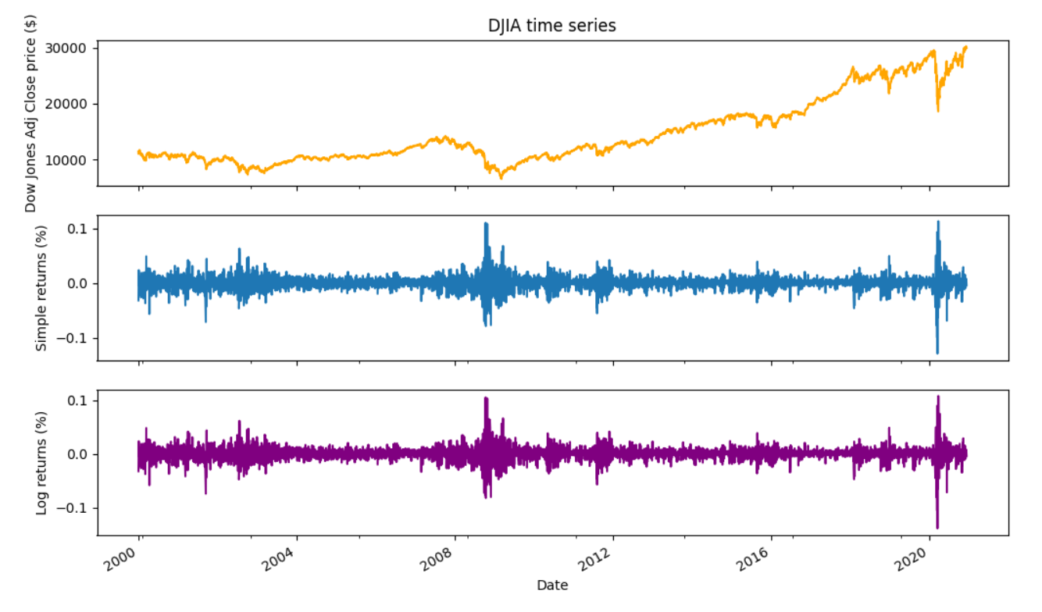
Djia simple & log returns

Slide 34
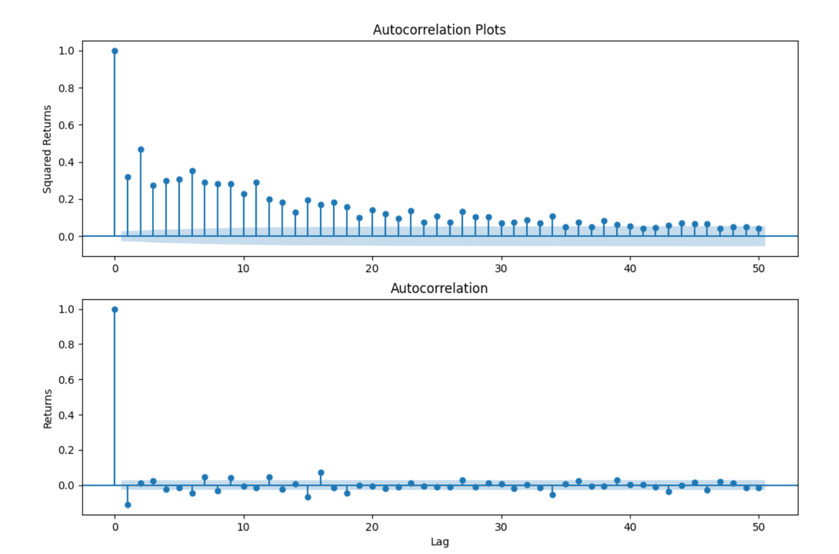
Autocorrelation plots

Slide 35
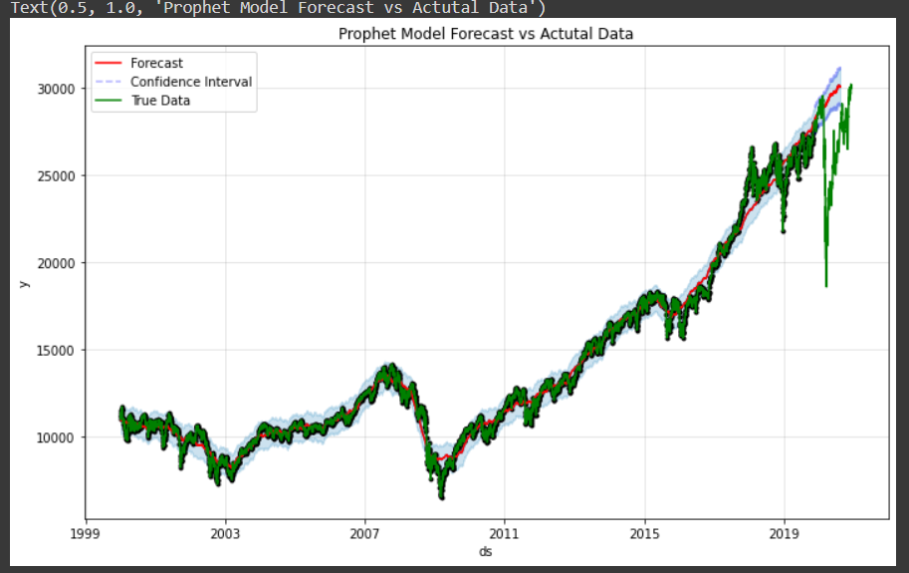
Prophet model on djia
This is our Forecast vs actual data using the prophet model for prediction of time series data. Here we can see that the model is not accurately able to discover a crash, but we can see an upward trend in the end of the which is corelating with the actual data.

Slide 36
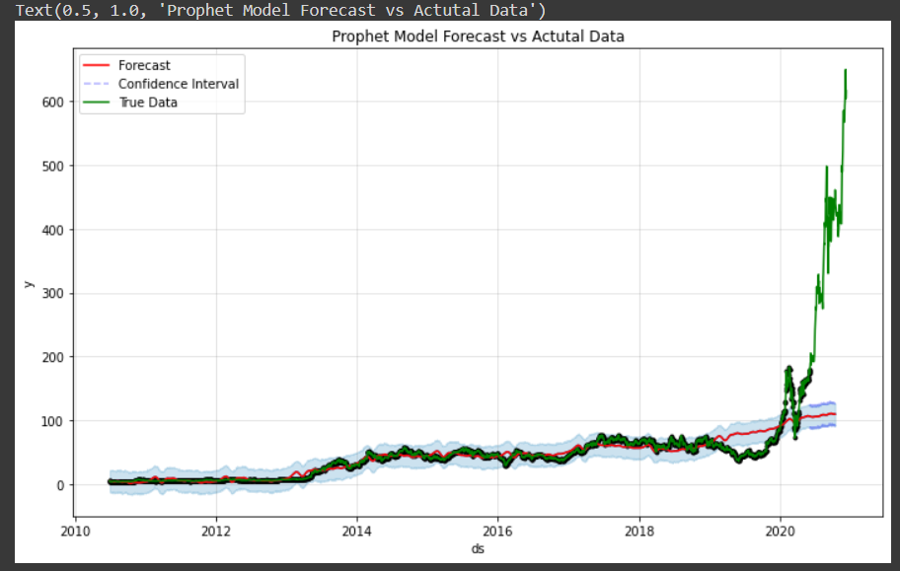
Prophet model on tesla stock
Here as we can see in Tesla Stock the Actual Trend and Predicted Trend varies drastically because we have not included the market trend such as news, economic scenario, insider updates etc. Hence, we get deviating results in the end. The momentum is still upwards for the stock but differs with actual data.
Here we can also say that the more volatile the market or stock, it becomes difficult to predict the trend.

Slide 37
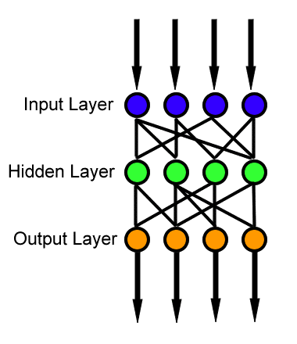
Feed Forward Neural network
A single hidden layer neural network is the simplest neural networks form. In this kind of single hidden layer form, there is only one layer of input nodes that send weighted inputs to the next layer of receiving nodes.
Source https://en.wikipedia.org/wiki/Feedforward_neural_network

Slide 38
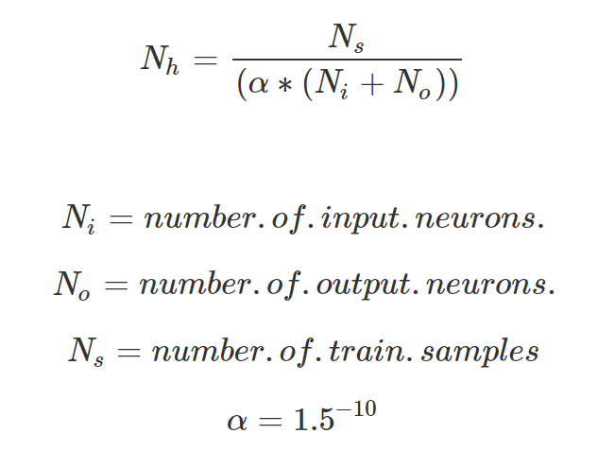
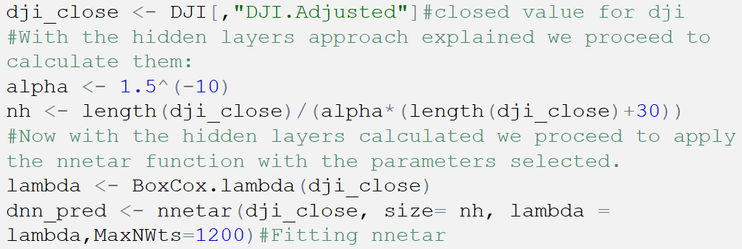
Feed Forward Neural network
For this approach we will select the specific number of hidden nodes as:

Slide 39
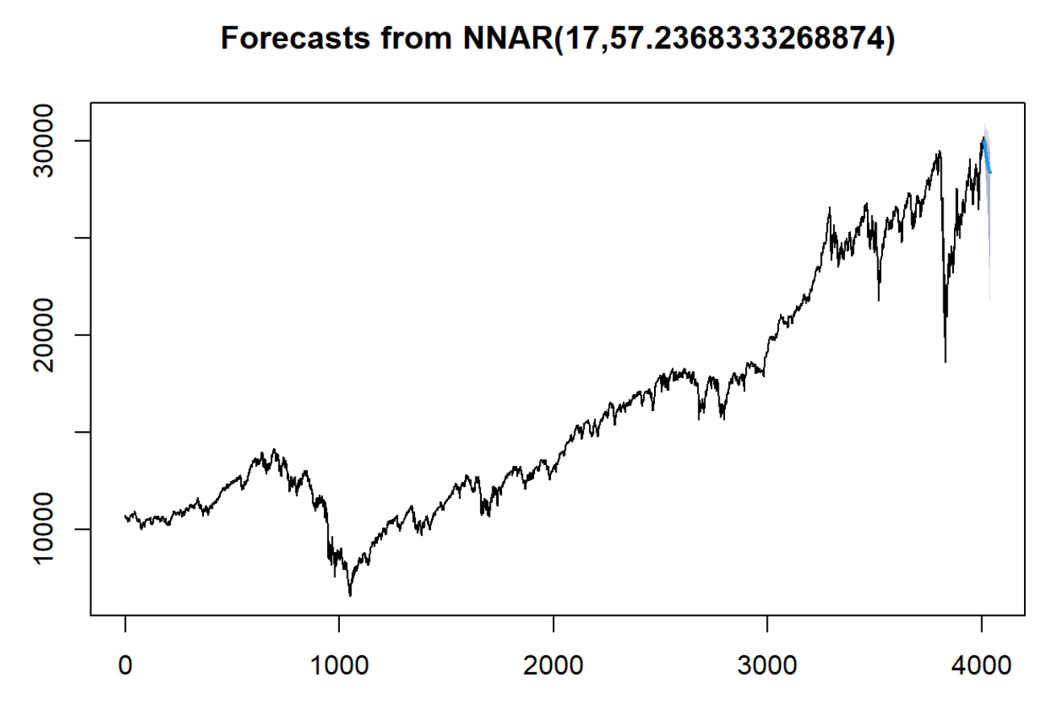
Feed Forward Neural network
We use a Box Cox lambda to ensure the residuals will be roughly homoscedastic. We forecast the next 30 days with the neural net fitted.
We get deviating results in the end. The momentum is still upwards for the stock but differs with actual data.

Slide 40

Artificial Neural Network
This time we found a multilayer perception which contains a three-layer with one hidden layer model trained with back-propagation algorithm.
According to some research it can be the most effective to forecast financial time series..

Slide 41
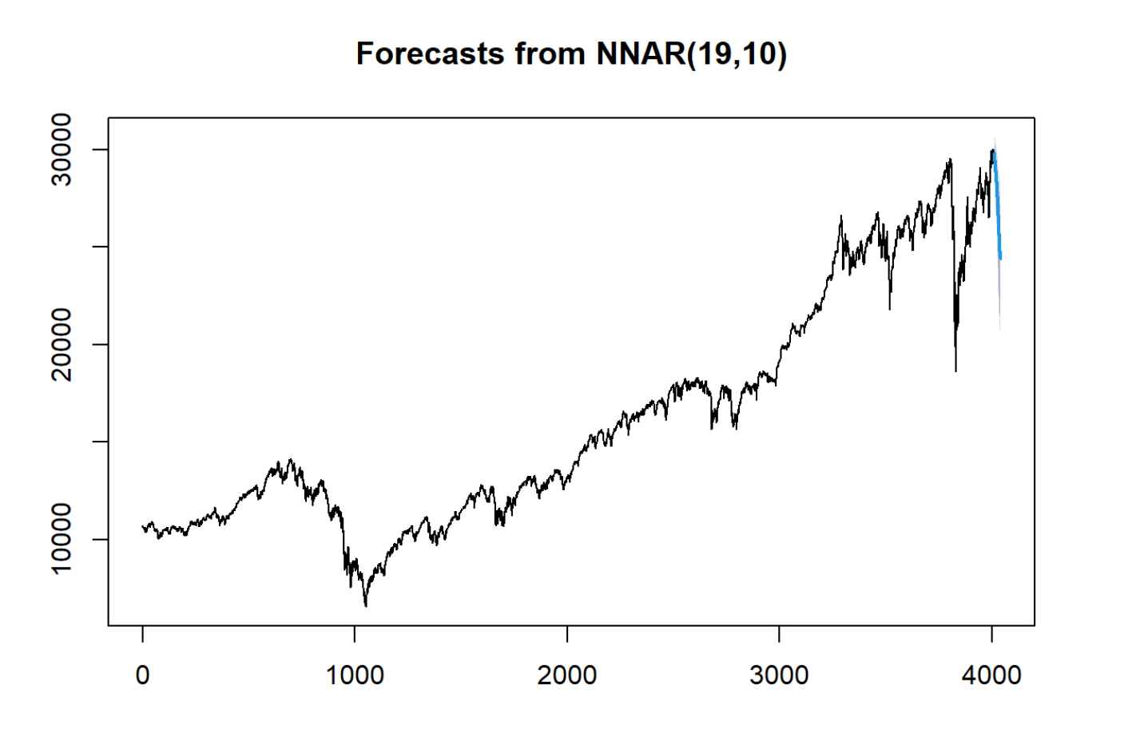
Artificial Neural Network
The training parameters were set as follows: decay rate = 0.00001, number of units in the hidden layer = 10, and epoch size = 10000.

Slide 42
K Nearest Neighbor (KNN) Forecast
Uses 'feature similarity' to predict the values of any new data points.
This means that the new point is assigned a value based on how closely it resembles the points in the training set
The most popular application is to use it for classification problems.
Variety of applications such as economic forecasting, data compression and genetics.

Slide 43
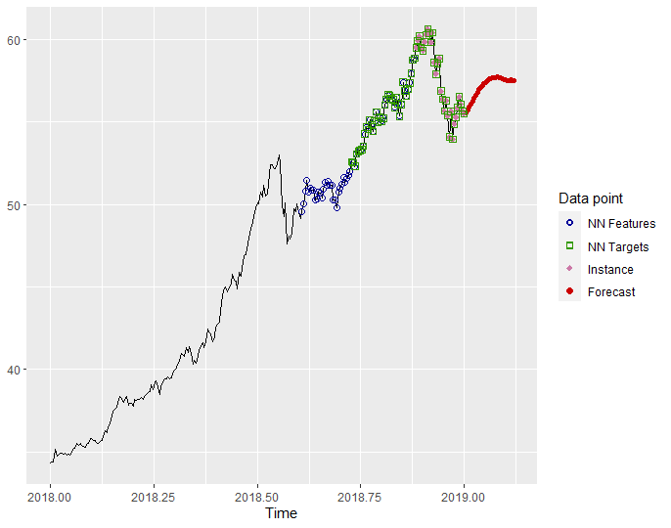
30 day KNn forecast
It is observed that the forecast is similar to the real DJIA data. It had an upward trend at the beginning of 2019 which can be seen in the forecast.

Slide 44
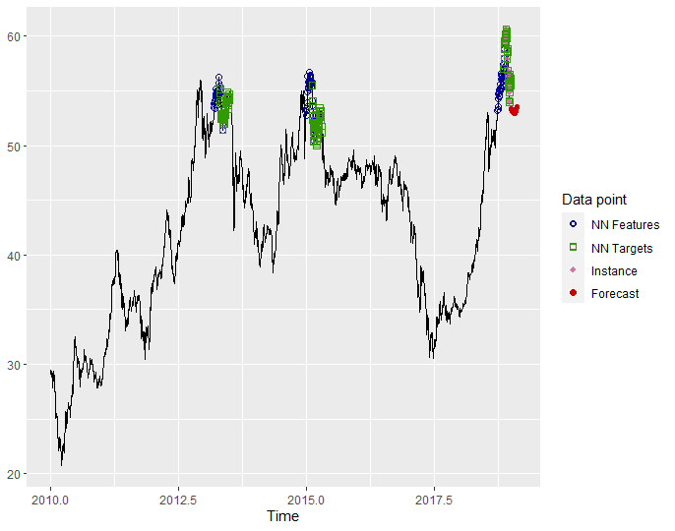
Accuracy
Similar forecast on a larger time scale shows the trend reversing at end of 2018
Overall accuracy stats :
RMSE MAE MAPE
4.416086 3.679488 6.408087

Slide 45
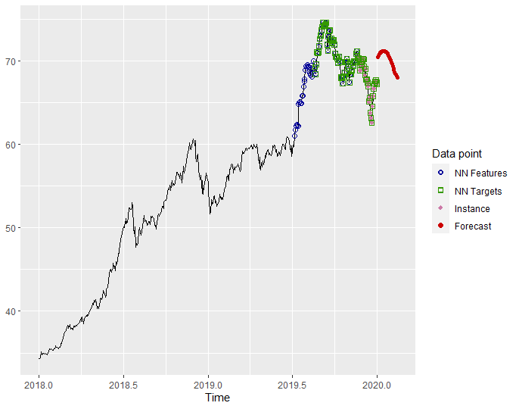
Accuracy
This forecast shows market going down in next 30 days which is not as consistent with real time data but it shows a downward trend for first quarter of 2020 which is what was seen.

Slide 46
Conclusion
The Dow Jones Index is very difficult to predict because so many different outside events factor into the index. Because of this unpredictability of factors no one model is better than the other. It may appear in our report that one model provided better predictions than other but with different market conditions this may not be the case.
For example, there was a huge dip in the market in early 2020 due to covid lockdowns. No such model would be able to predict something like this without being given that information.

Slide 47
THANK YOU For YOUR WATCHING

